Slide 1

Microsoft Teams User Group Berlin
25. Mai 2023
Meetup #24

Slide 2


Slide 3

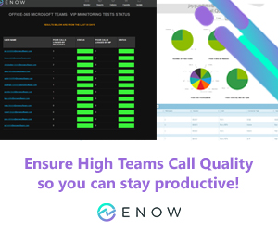
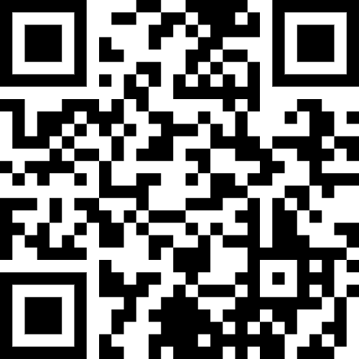

Slide 4
Agenda
18:00 - 18:15 | Landing Zone
18:15 - 19:00 | Talk 1 – Microsoft Teams Phone Mobile – ein Game Changer in der Telefonie Thorsten Pickhan
19:15 - 19:45 | Microsoft Teams Neuigkeiten Thomas Stensitzki (@stensitzki)
19:45 -20:30 | Talk 2 – Teams Premium – Was, Wie, Warum? Christian Olschewski / Thomas Stensitzki
19:45 - ? | Fragen und Antworten rund um Microsoft Teams Organisatorisches
Dieses Meeting wird aufgezeichnet und online auf YoutTube bereitgestellt. This meeting will be recorded and made available online.

Slide 5
Microsoft Teams Phone Mobile – ein Game Changer in der Telefonie
Thorsten Pickhan

Slide 7
Neues in Microsoft Teams Ankündigungen & Rollouts
Updates
Meetup #24 Thomas Stensitzki

Slide 8
Neuigkeiten in Microsoft Teams
A new experience to search within chat and channels
Virtual Meetings - Two-way lobby chat
Intelligent Meeting Recap
Creation of Default Notes tab in new standard channels in Teams
Live translated captions for meetings requires Teams Premium license
Default Meeting Layout Controls for Teams Rooms on Android
Avatars for Microsoft Teams
Together Mode Usability Improvements in Teams Meetings

Slide 9
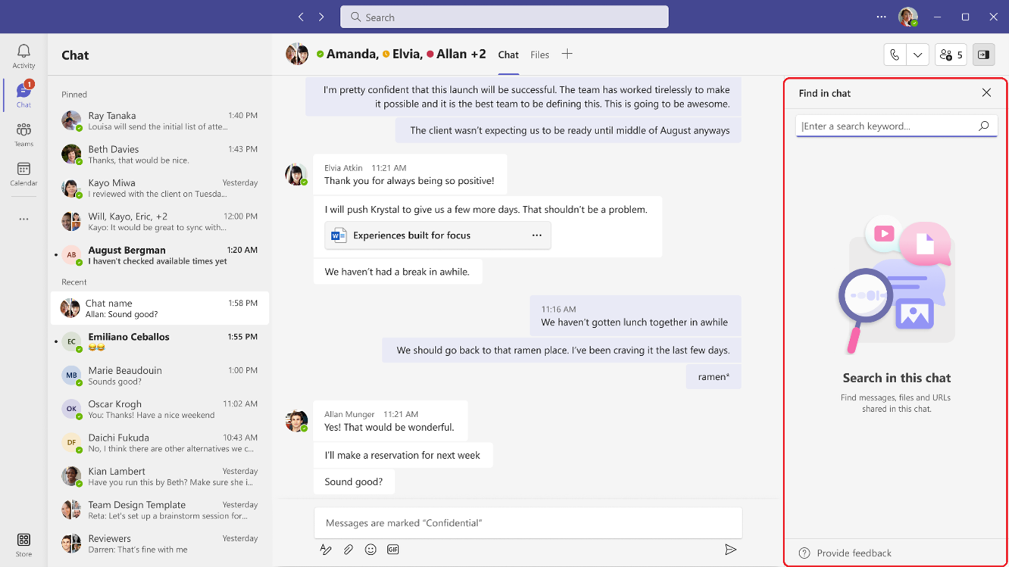
A new experience to search within chat and channels

Slide 10
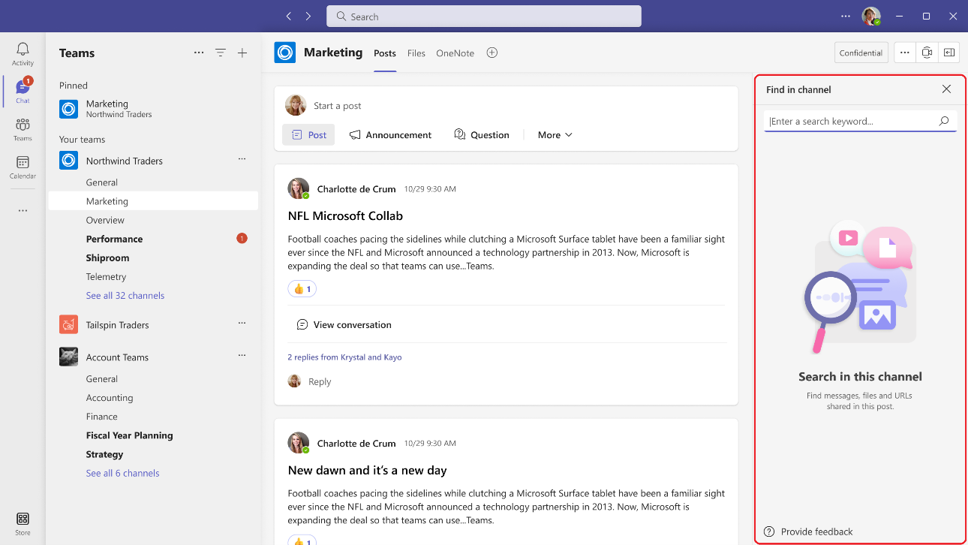
A new experience to search within chat and channels

Slide 11
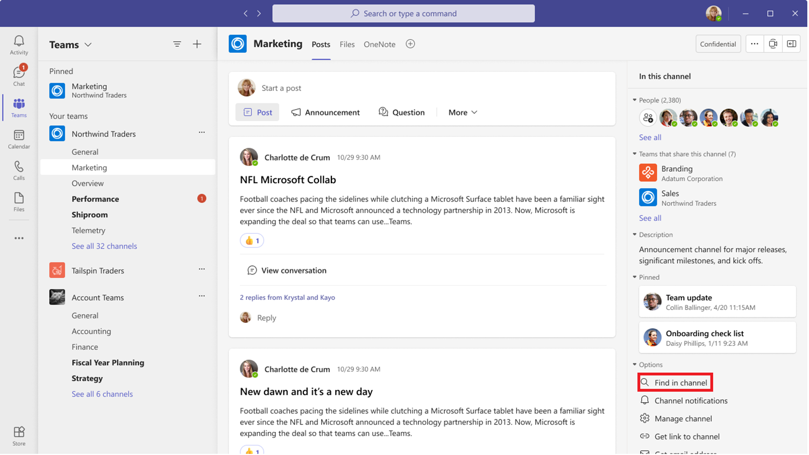
A new experience to search within chat and channels

Slide 12
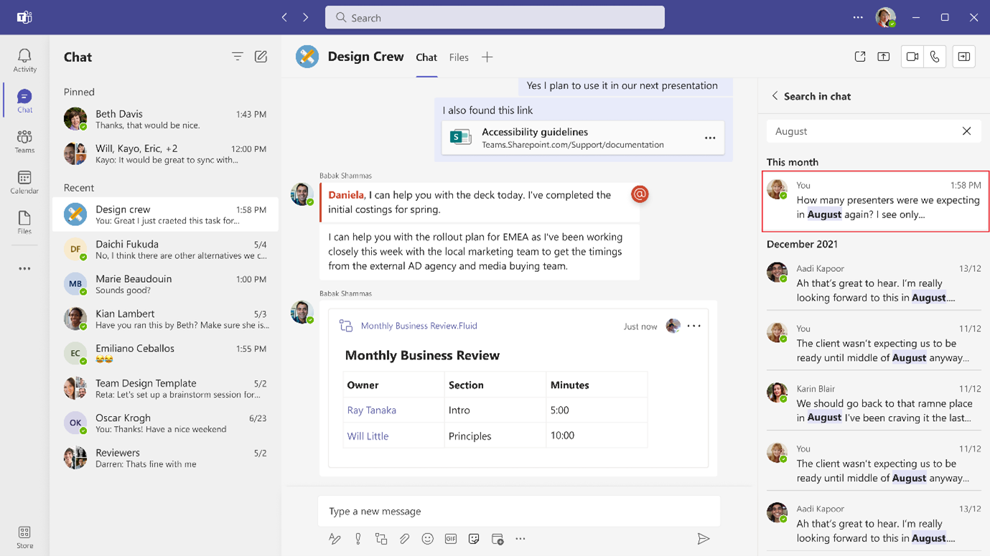
A new experience to search within chat and channels

Slide 13
Neuigkeiten in Microsoft Teams
A new experience to search within chat and channels
Virtual Meetings - Two-way lobby chat
Intelligent Meeting Recap
Creation of Default Notes tab in new standard channels in Teams
Live translated captions for meetings requires Teams Premium license
Default Meeting Layout Controls for Teams Rooms on Android
Avatars for Microsoft Teams
Together Mode Usability Improvements in Teams Meetings

Slide 14
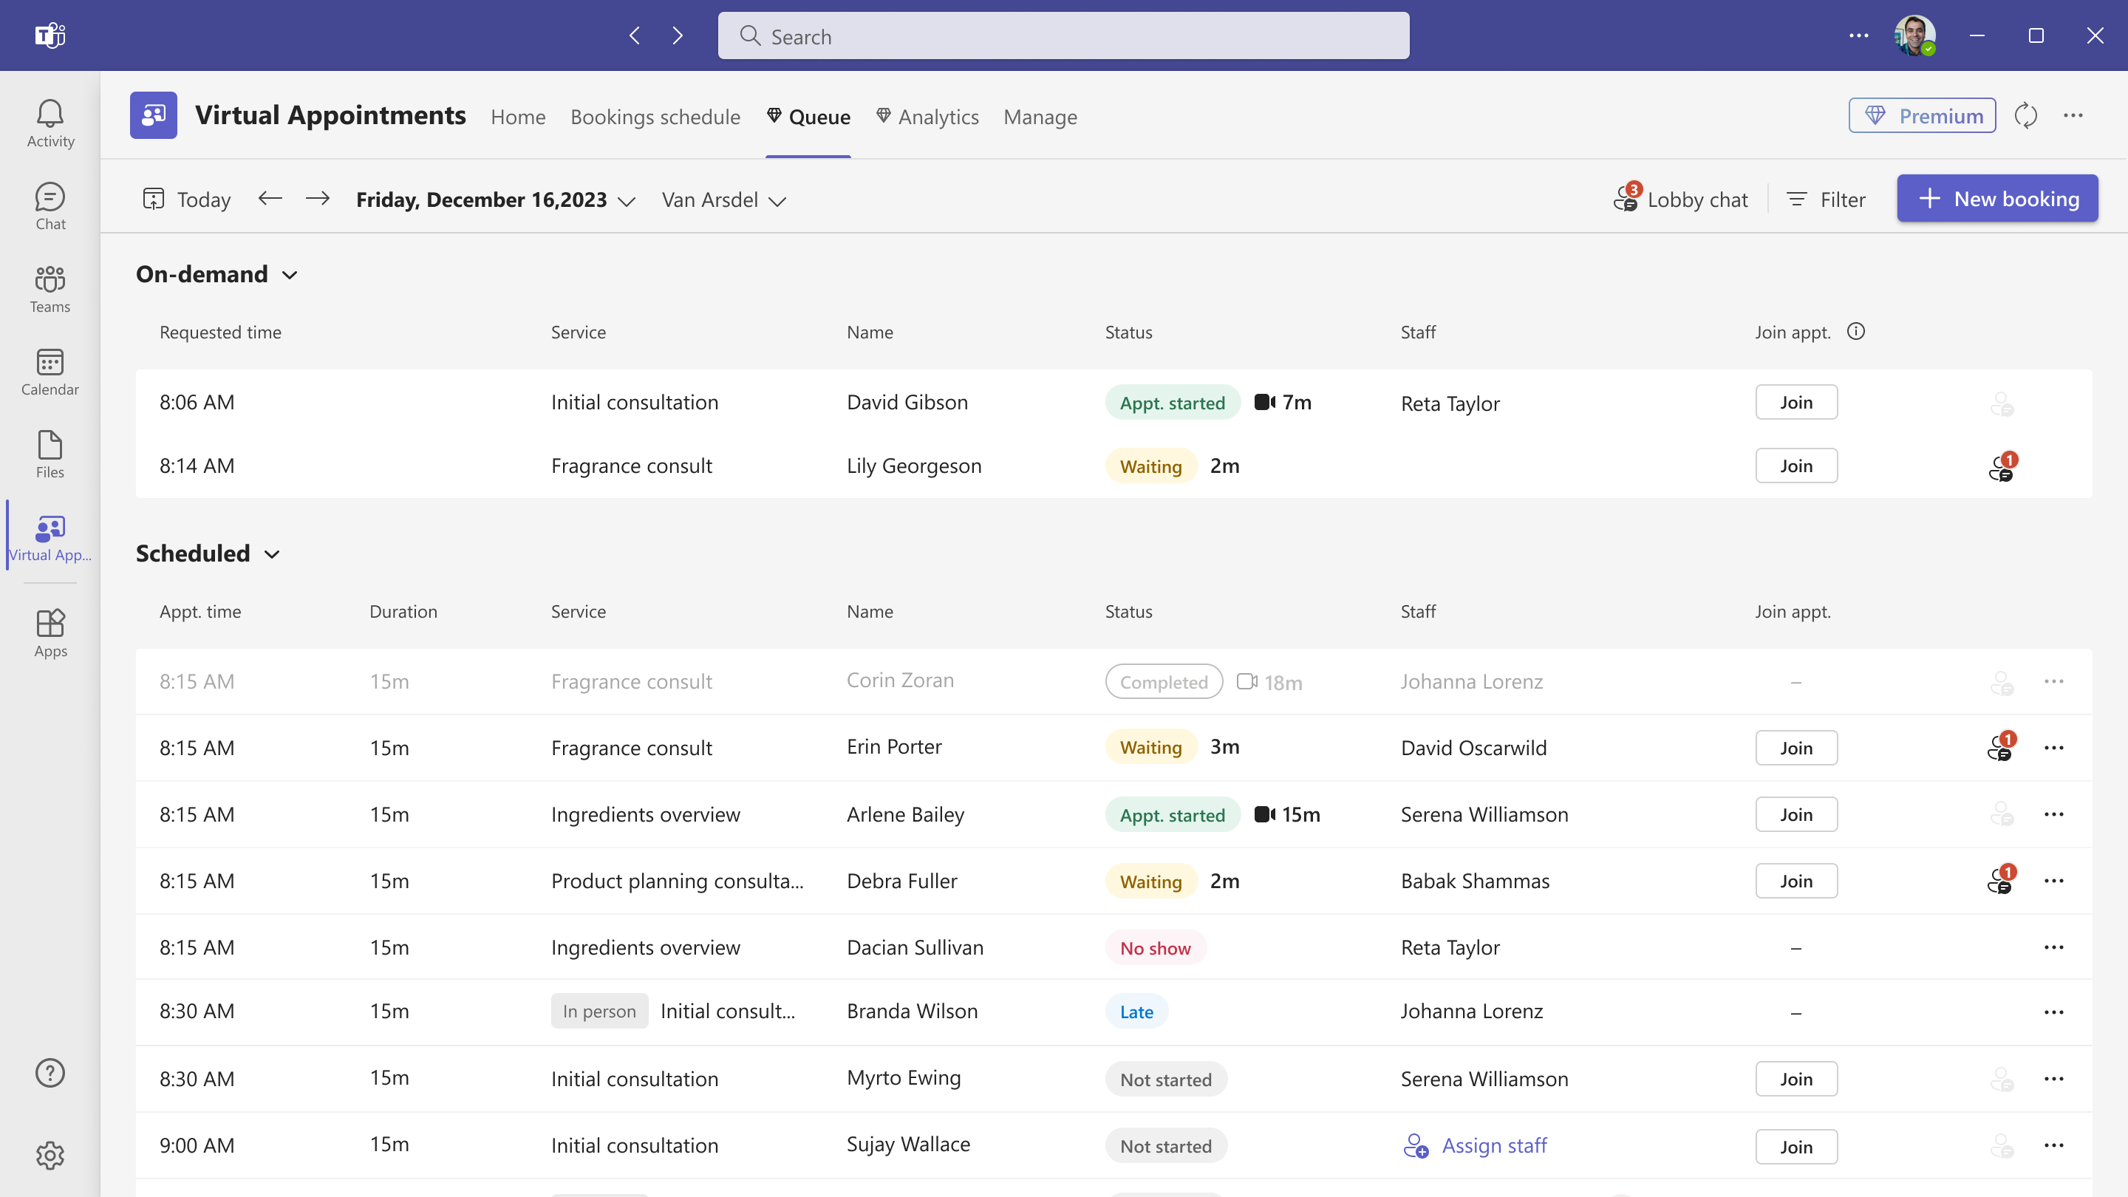
Virtual Meetings - Two-way lobby chat

Slide 15
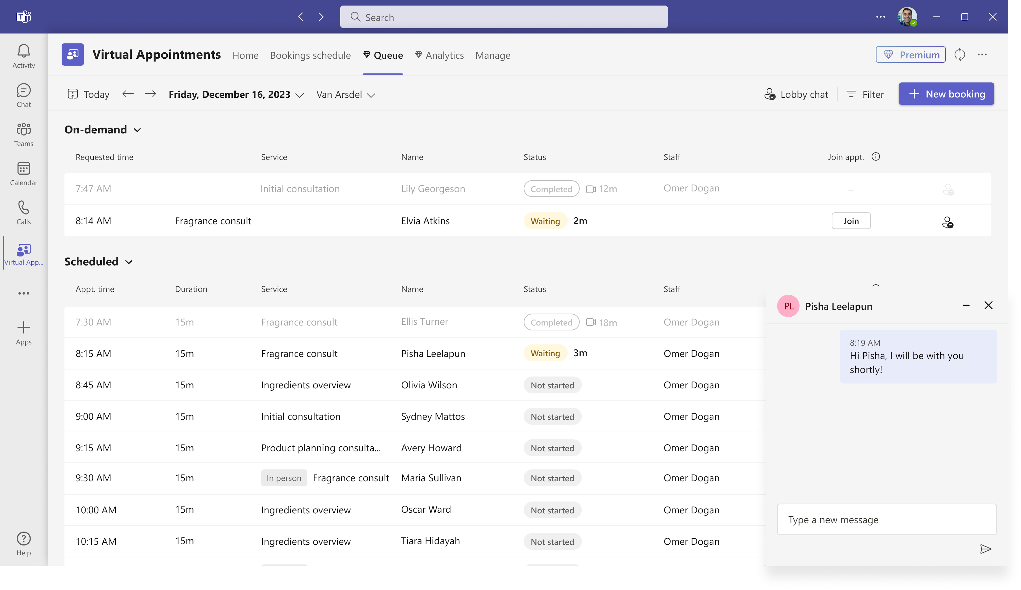
Virtual Meetings - Two-way lobby chat

Slide 16
Neuigkeiten in Microsoft Teams
A new experience to search within chat and channels
Virtual Meetings - Two-way lobby chat
Intelligent Meeting Recap
Creation of Default Notes tab in new standard channels in Teams
Live translated captions for meetings requires Teams Premium license
Default Meeting Layout Controls for Teams Rooms on Android
Avatars for Microsoft Teams
Together Mode Usability Improvements in Teams Meetings

Slide 17
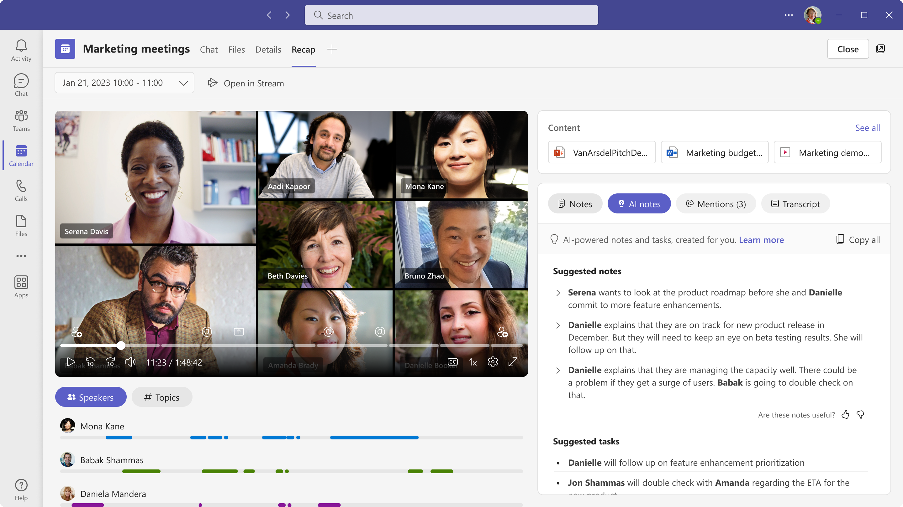
Intelligent Meeting Recap (Premium)
Notes:
For users with a Teams Premium license, Intelligent Meeting Recap is a comprehensive AI-powered meeting recap experience that helps users catch-up, recall, and follow-up on hour-long meetings in minutes by providing recording and transcription playback with AI assistance. Located on the new ‘Recap’ tab in Teams calendar and Chat app, this experience also allows users to browse the recording by speakers, and topics, as well as access AI-generated suggested notes, suggested tasks, and @mentions.
AI generated notes/tasks are not going to be available for EU tenants during the initial release in May. We will communicate the availability later.
Part of Intelligent recap features will only be available for meetings happening in English during the initial release in May. We will communicate the availability in other languages later.
The Collaborative Meeting Notes component will begin rolling out late June and expect to complete by late July.
Topics are not going to be available during the initial release in May. We will communicate the availability later.

Slide 18
Neuigkeiten in Microsoft Teams
A new experience to search within chat and channels
Virtual Meetings - Two-way lobby chat
Intelligent Meeting Recap
Creation of Default Notes tab in new standard channels in Teams
Live translated captions for meetings requires Teams Premium license
Default Meeting Layout Controls for Teams Rooms on Android
Avatars for Microsoft Teams
Together Mode Usability Improvements in Teams Meetings

Slide 19
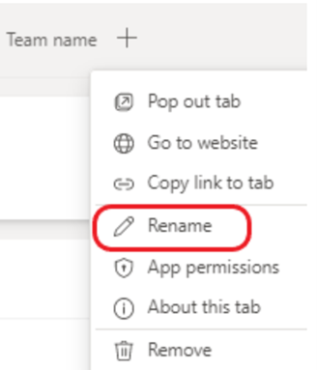
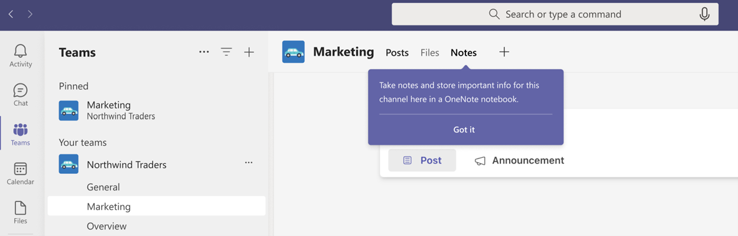
Creation of Default Notes tab in new standard channels in Teams
Notes:
https://learn.microsoft.com/de-de/deployoffice/deployment-guide-onenote
Please note that Notes tab by default is only supported in standard channels at the moment. If your standard channel used to have a Notes tab, you can add it back.

Slide 20
Neuigkeiten in Microsoft Teams
A new experience to search within chat and channels
Virtual Meetings - Two-way lobby chat
Intelligent Meeting Recap
Creation of Default Notes tab in new standard channels in Teams
Live translated captions for meetings requires Teams Premium license
Default Meeting Layout Controls for Teams Rooms on Android
Avatars for Microsoft Teams
Together Mode Usability Improvements in Teams Meetings

Slide 21
Live translated captions for meetings requires Teams Premium license
Anwender mit einer Teams Premium Lizenz
Teilnehmer in einer Besprechung, dessen Organisator über eine Teams Premium Lizenz verfügt
April 2023 – Teams Premium Lizenz erforderlich
Juli 2023 – Durchsetzung der Lizenzanforderungen

Slide 22
Neuigkeiten in Microsoft Teams
A new experience to search within chat and channels
Virtual Meetings - Two-way lobby chat
Intelligent Meeting Recap
Creation of Default Notes tab in new standard channels in Teams
Live translated captions for meetings requires Teams Premium license
Default Meeting Layout Controls for Teams Rooms on Android
Avatars for Microsoft Teams
Together Mode Usability Improvements in Teams Meetings

Slide 23
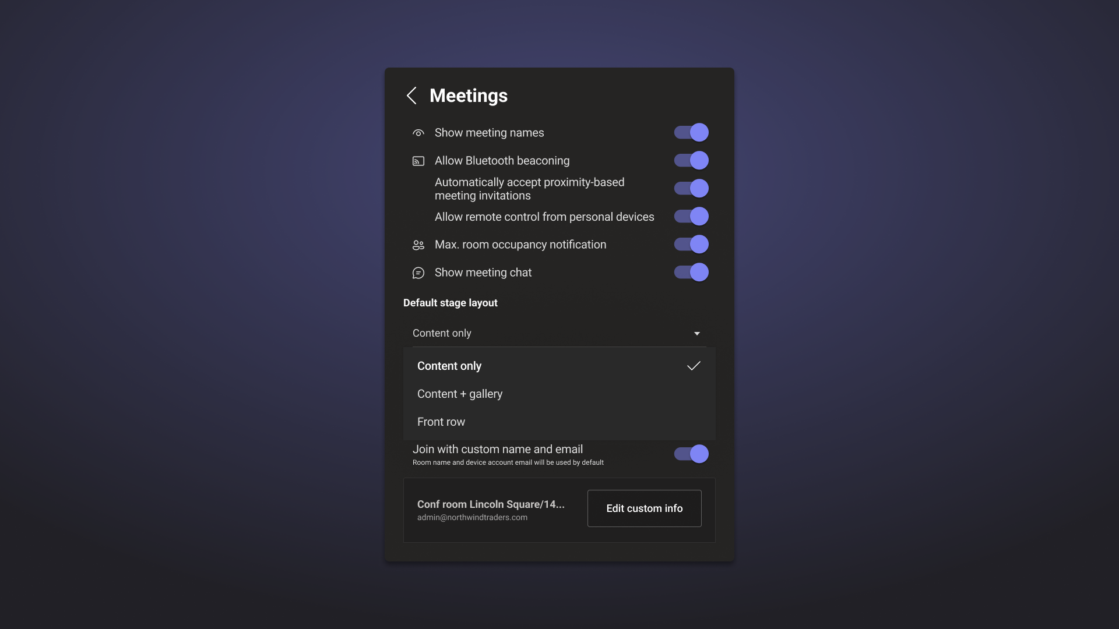
Default Meeting Layout Controls for Teams Rooms on Android
Notes:
IT admins can choose the default meeting layout by selecting Content only and Content + Gallery when content sharing begins. Standard, Premium, and Pro customers can also choose Front Row as the default layout

Slide 24
Neuigkeiten in Microsoft Teams
A new experience to search within chat and channels
Virtual Meetings - Two-way lobby chat
Intelligent Meeting Recap
Creation of Default Notes tab in new standard channels in Teams
Live translated captions for meetings requires Teams Premium license
Default Meeting Layout Controls for Teams Rooms on Android
Avatars for Microsoft Teams
Together Mode Usability Improvements in Teams Meetings

Slide 25
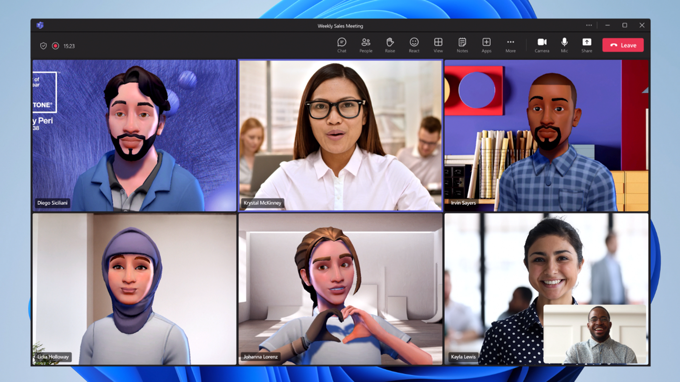
Avatars for Microsoft Teams
Microsoft 365 Enterprise E3
Microsoft 365 Enterprise E5
Microsoft 365 Business Standard
Microsoft 365 Business Premium
Teams Premium
Notes:
While in Public Preview, Avatars for Microsoft Teams was supported for all SKUs. However, at General Availability, Avatars for Microsoft Teams will only be supported for the following SKUs: Microsoft 365 Enterprise E3, Microsoft 365 Enterprise E5, Microsoft 365 Business Standard, Microsoft 365 Business Premium or Teams Premium.
https://techcommunity.microsoft.com/t5/microsoft-teams-blog/avatars-for-microsoft-teams-in-public-preview/ba-p/3774421

Slide 26
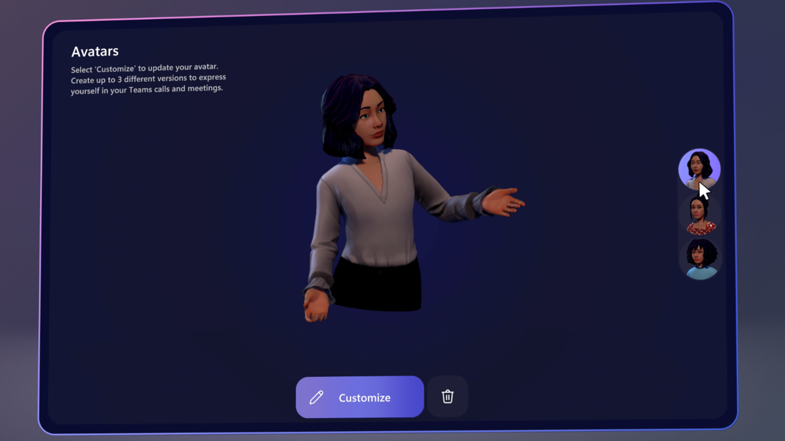
Avatars for Microsoft Teams
Notes:
While in Public Preview, Avatars for Microsoft Teams was supported for all SKUs. However, at General Availability, Avatars for Microsoft Teams will only be supported for the following SKUs: Microsoft 365 Enterprise E3, Microsoft 365 Enterprise E5, Microsoft 365 Business Standard, Microsoft 365 Business Premium or Teams Premium.

Slide 27
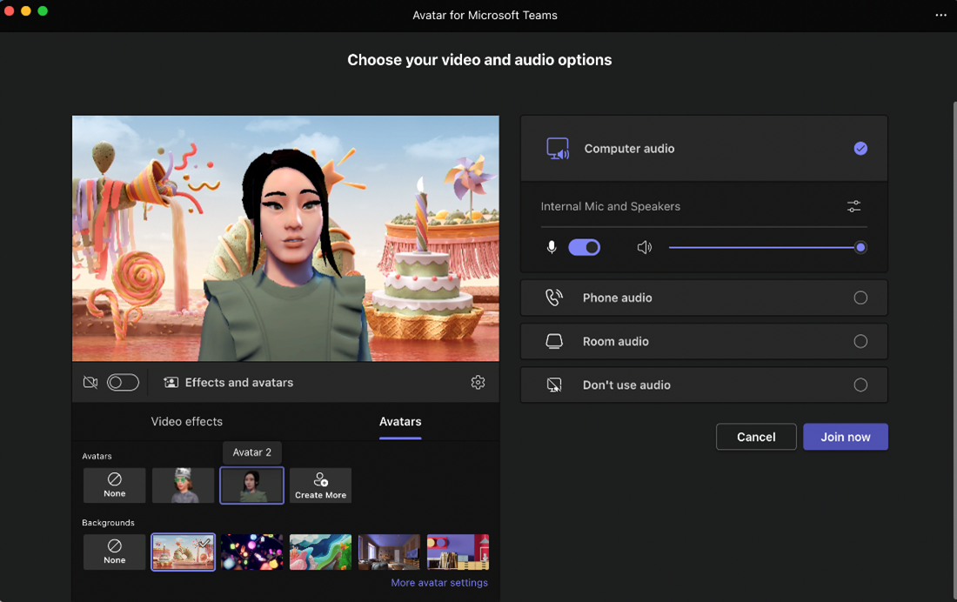
Avatars for Microsoft Teams
Notes:
While in Public Preview, Avatars for Microsoft Teams was supported for all SKUs. However, at General Availability, Avatars for Microsoft Teams will only be supported for the following SKUs: Microsoft 365 Enterprise E3, Microsoft 365 Enterprise E5, Microsoft 365 Business Standard, Microsoft 365 Business Premium or Teams Premium.

Slide 28
Neuigkeiten in Microsoft Teams
A new experience to search within chat and channels
Virtual Meetings - Two-way lobby chat
Intelligent Meeting Recap
Creation of Default Notes tab in new standard channels in Teams
Live translated captions for meetings requires Teams Premium license
Default Meeting Layout Controls for Teams Rooms on Android
Avatars for Microsoft Teams
Together Mode Usability Improvements in Teams Meetings

Slide 29
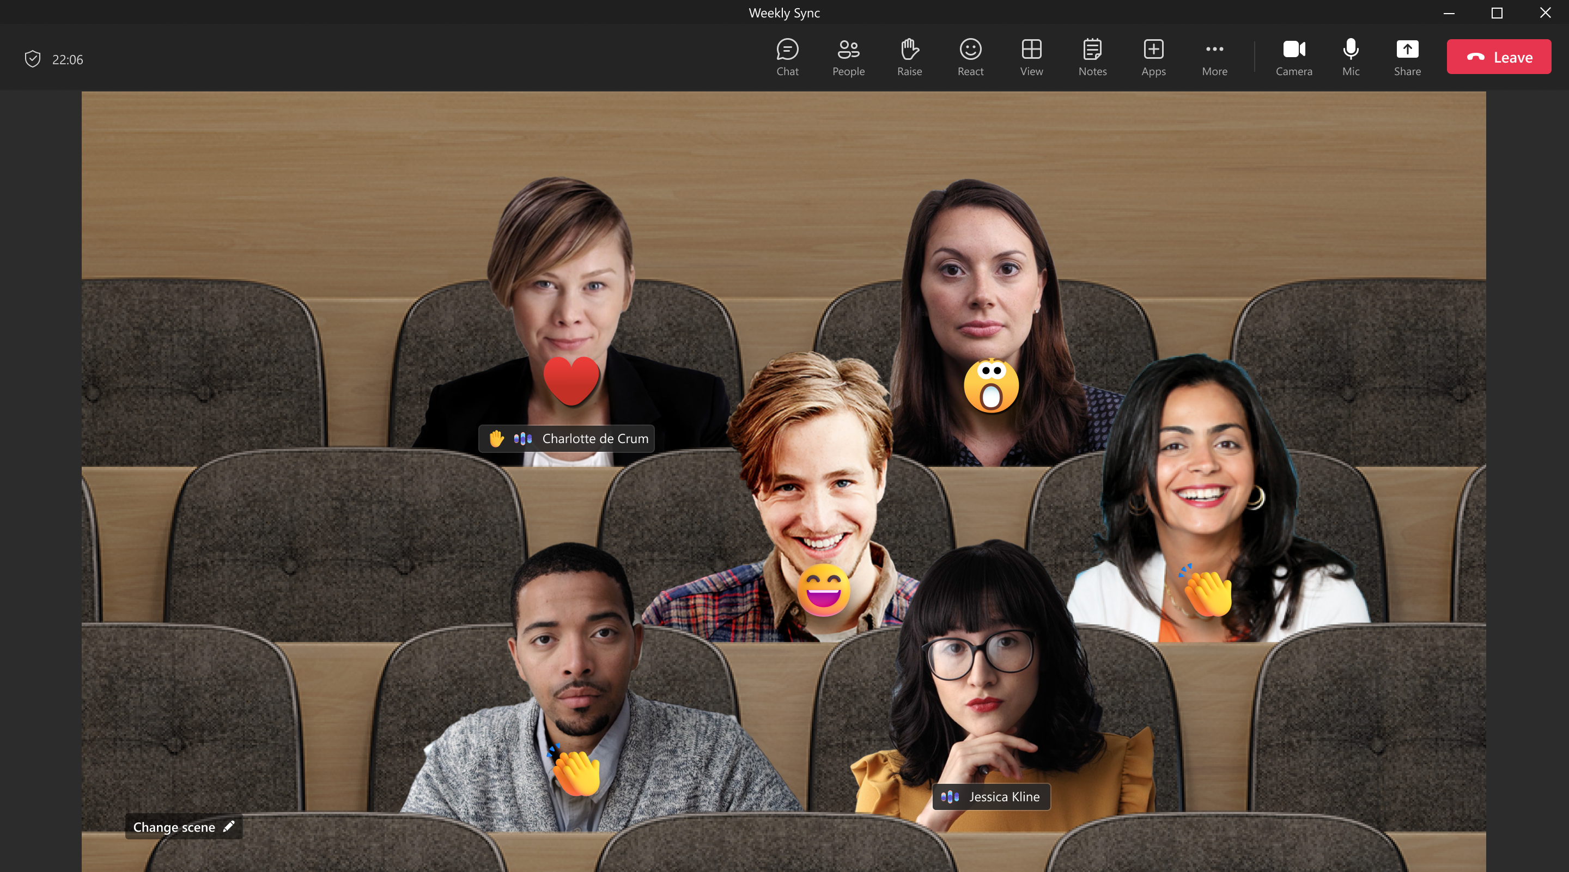
Together Mode Usability Improvements in Teams Meetings
Notes:
Participants in Together Mode will have name labels attached to their videos. Name labels will also support status icons that indicate microphone, active speaker, spotlight or pin within the meeting. Additionally, your own video in the gallery will now be removed while Together Mode is active to avoid duplication of the self-preview. Lastly, Together Mode will display raised hands and reactions within the view.

Slide 30
Neuigkeiten in Microsoft Teams
Collaborative Meeting Notes
Intelligent Meeting Recap in Microsoft 365 Feed

Slide 31
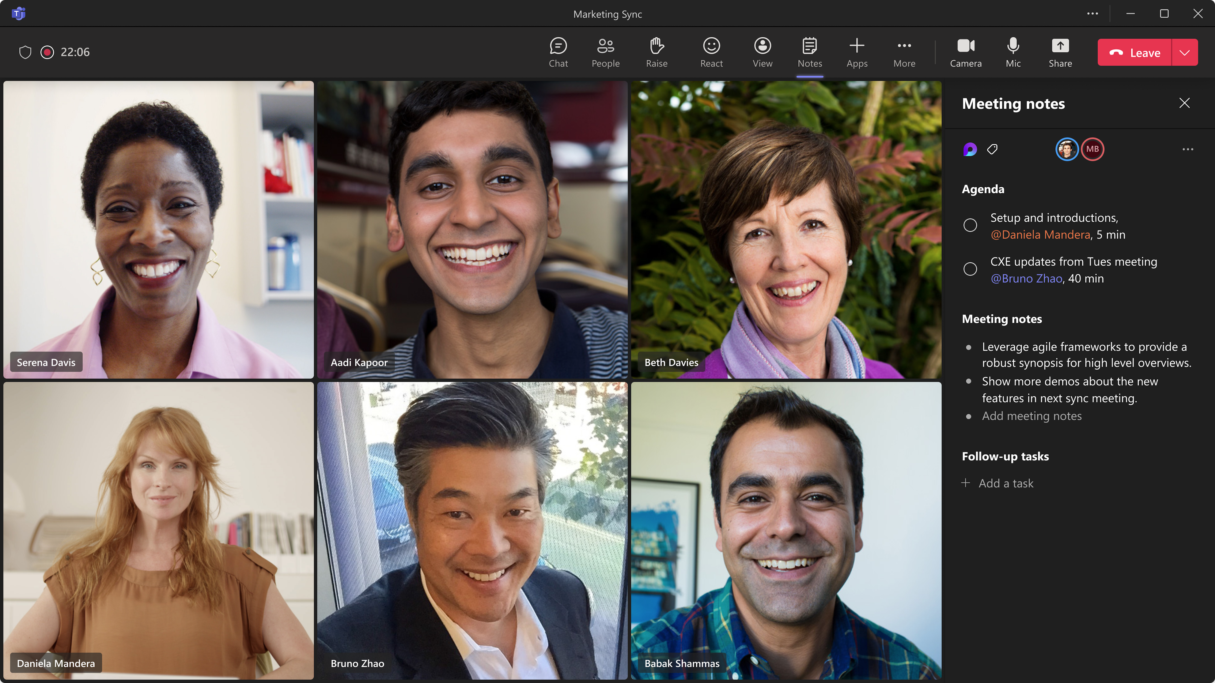
Collaborative Meeting Notes
Notes:
More specifically, we’re improving how you track what you want to discuss (Agenda), what you discussed/decided (Notes) and what you need to follow up on (Follow-up Tasks). These capabilities are now integrated into the end-to-end meeting experience in Teams, Loop, Planner, To Do, Office.com and OneDrive for Business.

Slide 32
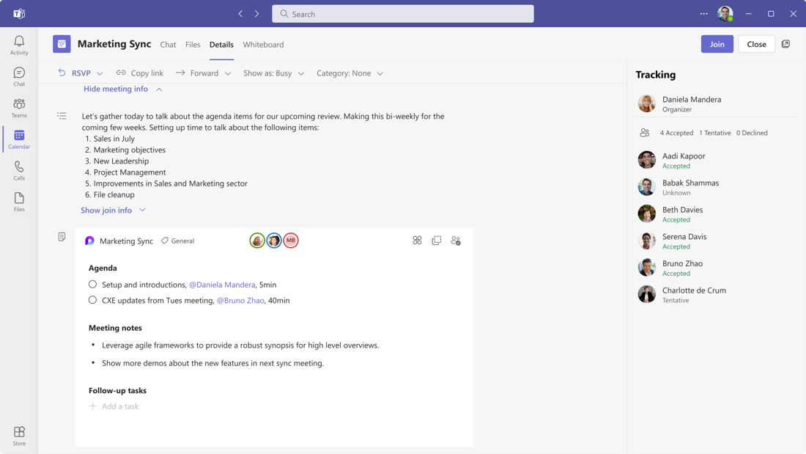
Collaborative Meeting Notes
Notes:
Nothing is required to prepare. This capability will be enabled by default when it rolls out.
Note: the new Collaborative notes file will generate a Company Shareable Link (CSL) by default.
You can manage this feature via SharePoint PowerShell with:
Set-SPOTenant -IsCollabMeetingNotesFluidEnabled (boolean)
https://learn.microsoft.com/de-de/sharepoint/manage-loop-components#settings-management-for-loop-functionality-in-teams

Slide 33
Neuigkeiten in Microsoft Teams
Collaborative Meeting Notes
Intelligent Meeting Recap in Microsoft 365 Feed

Slide 34
Intelligent Meeting Recap in Microsoft 365 Feed
Teams Premium
Ohne Teams Premium
What’s in the card?
Indication of which part of the meeting you missed
Automatically generated AI tasks
When your name was mentioned
List of top speakers
Quick links to the full meeting recap and recording
What’s next?
Starting gradual rollout to GA by the end of April
GPT-based AI meeting notes
Recommending key meetings you attended
Rolling out to the Outlook Mobile feed
Showing Files related to the meeting
What’s in the card?
List of speakers
Quick link to the full meeting recap and recording
What’s next?
Starting gradual rollout to GA during May
Rolling out to the Outlook Mobile feed
Showing Files related to the meeting

Slide 35
Neues in Microsoft Teams Ankündigungen & Rollouts für Admins
Updates
Meetup #24 Thomas Stensitzki

Slide 36
Neuigkeiten in Microsoft Teams für Admins
New Microsoft Teams Continuous Web Logs Extend the Window for Troubleshooting
Discover Azure Benefit Eligible Apps and View Unspent Azure Consumption Commitment Weitere Informationen
Self-service trial experience available for Teams Exploratory
Block Anonymous Users' Meeting Chat Read Access in Addition to Current Write Access
Microsoft Teams Rooms on Android: User Experience Update 1 2023

Slide 37
New Microsoft Teams Continuous Web Logs Extend the Window for Troubleshooting
Erweiterte und kontinuierliche Protokollierung für einen Tag
TeamsMediaLoggingPolicy per PowerShell
Konfiguration per Teams Admin Center folgt
Feature ist standardmäßig deaktiviert

Slide 38
Neuigkeiten in Microsoft Teams für Admins
New Microsoft Teams Continuous Web Logs Extend the Window for Troubleshooting
Discover Azure Benefit Eligible Apps and View Unspent Azure Consumption Commitment Weitere Informationen
Self-service trial experience available for Teams Exploratory
Block Anonymous Users' Meeting Chat Read Access in Addition to Current Write Access
Microsoft Teams Rooms on Android: User Experience Update 1 2023

Slide 39
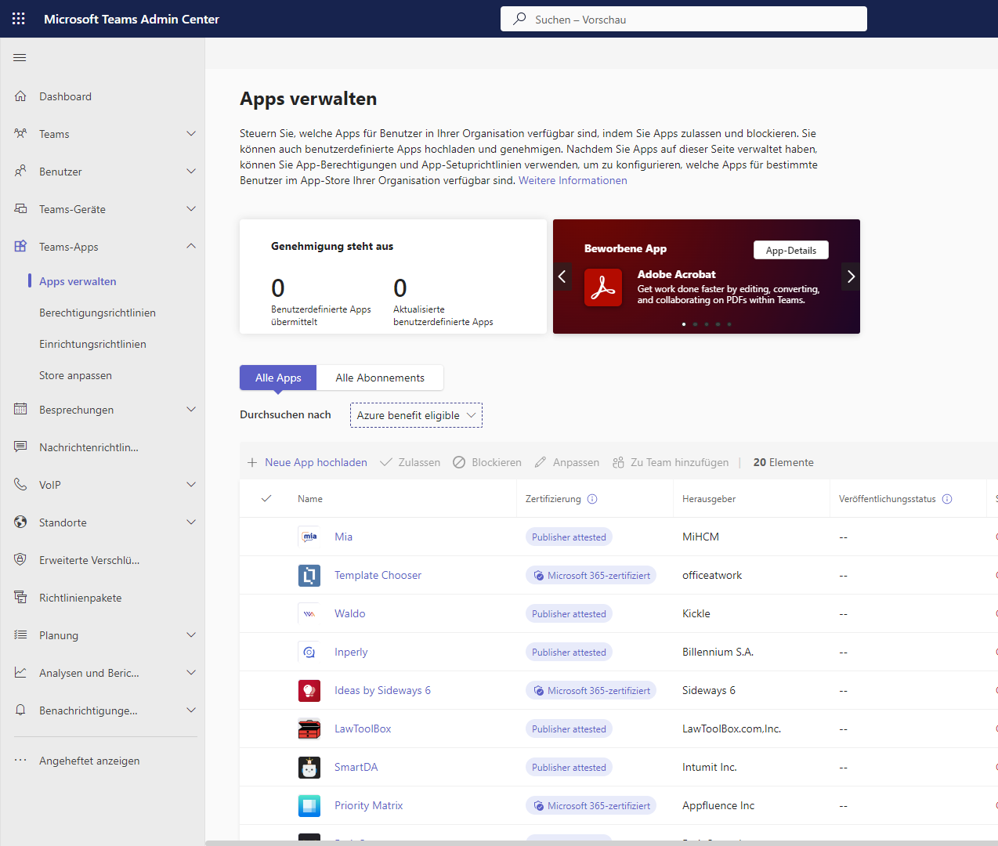
Discover Azure Benefit Eligible Apps and View Unspent Azure Consumption Commitment
Finden von Teams Apps, die auf das Microsoft Azure Consumption Commitment (MACC) angerechnet werden
Funktionsparität mit dem Azure Portal
Einfache Zuordnung, um MACC auszunutzen
Nur sichtbar in Mandanten mit MACC und entsprechender Berechtigung

Slide 40
Neuigkeiten in Microsoft Teams für Admins
New Microsoft Teams Continuous Web Logs Extend the Window for Troubleshooting
Discover Azure Benefit Eligible Apps and View Unspent Azure Consumption Commitment Weitere Informationen
Self-service trial experience available for Teams Exploratory
Block Anonymous Users' Meeting Chat Read Access in Addition to Current Write Access
Microsoft Teams Rooms on Android: User Experience Update 1 2023

Slide 41
Self-service trial experience available for Teams Exploratory
Anwender können eigenständig eine Teams Exploratory Testversion beginnen
Eine Exploratory Lizenz kann in eine kostenpflichtige Lizenz gewandelt werden
Die Verfügbarkeit von Self-Service Testversion kann von Globalen Administratoren und Rechnungsadministratoren kontrolliert werden
Verwenden von AllowSelfServicePurchase für das MSCommerce PowerShell-Modul
Verwalten von Self-Service-Käufen und Testversionen (für Administratoren)

Slide 42
Neuigkeiten in Microsoft Teams für Admins
New Microsoft Teams Continuous Web Logs Extend the Window for Troubleshooting
Discover Azure Benefit Eligible Apps and View Unspent Azure Consumption Commitment Weitere Informationen
Self-service trial experience available for Teams Exploratory
Block Anonymous Users' Meeting Chat Read Access in Addition to Current Write Access
Microsoft Teams Rooms on Android: User Experience Update 1 2023

Slide 43
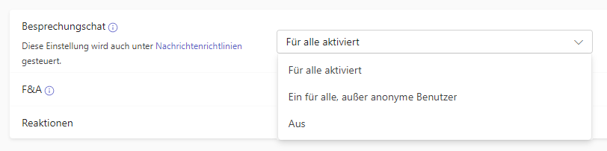
Block Anonymous Users' Meeting Chat Read Access in Addition to Current Write Access
Sperrung des Besprechungschats für anonym Teilnehmende
Verwalten von Chats in Teams-Besprechungen

Slide 44
Neuigkeiten in Microsoft Teams für Admins
New Microsoft Teams Continuous Web Logs Extend the Window for Troubleshooting
Discover Azure Benefit Eligible Apps and View Unspent Azure Consumption Commitment Weitere Informationen
Self-service trial experience available for Teams Exploratory
Block Anonymous Users' Meeting Chat Read Access in Addition to Current Write Access
Microsoft Teams Rooms on Android: User Experience Update 1 2023

Slide 45
Neuigkeiten in Microsoft Teams für Admins
New Microsoft Teams Continuous Web Logs Extend the Window for Troubleshooting
Discover Azure Benefit Eligible Apps and View Unspent Azure Consumption Commitment Weitere Informationen
Self-service trial experience available for Teams Exploratory
Block Anonymous Users' Meeting Chat Read Access in Addition to Current Write Access
Microsoft Teams Rooms on Android: User Experience Update 1 2023

Slide 46
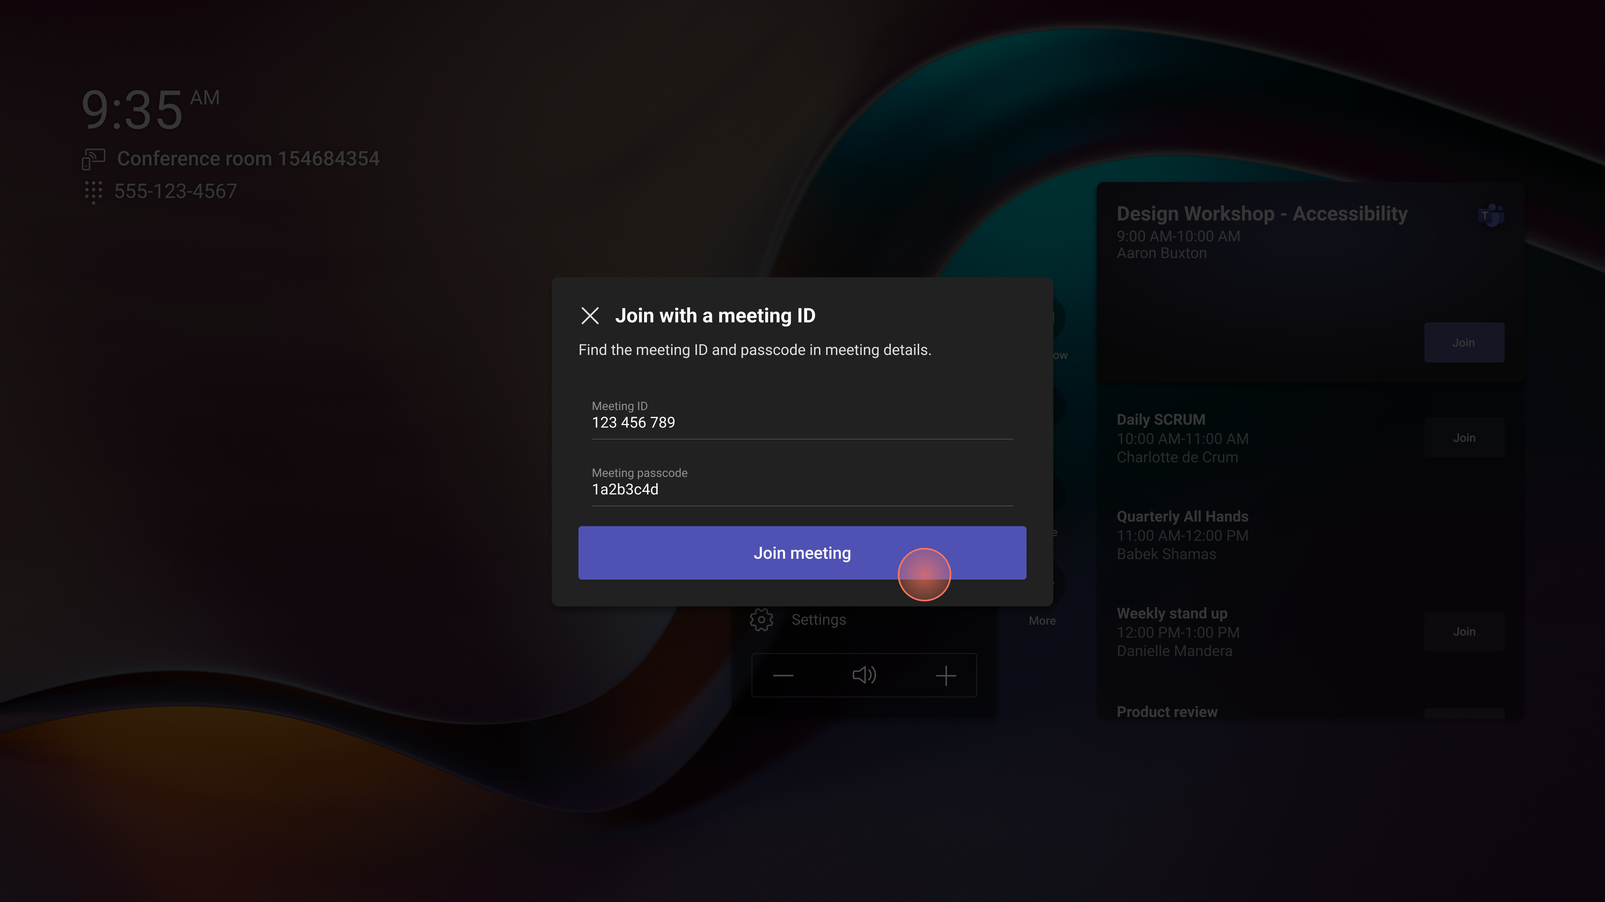
Microsoft Teams Rooms on Android: User Experience Update 1 2023
Notes:
Join Teams meeting with ID

Slide 47
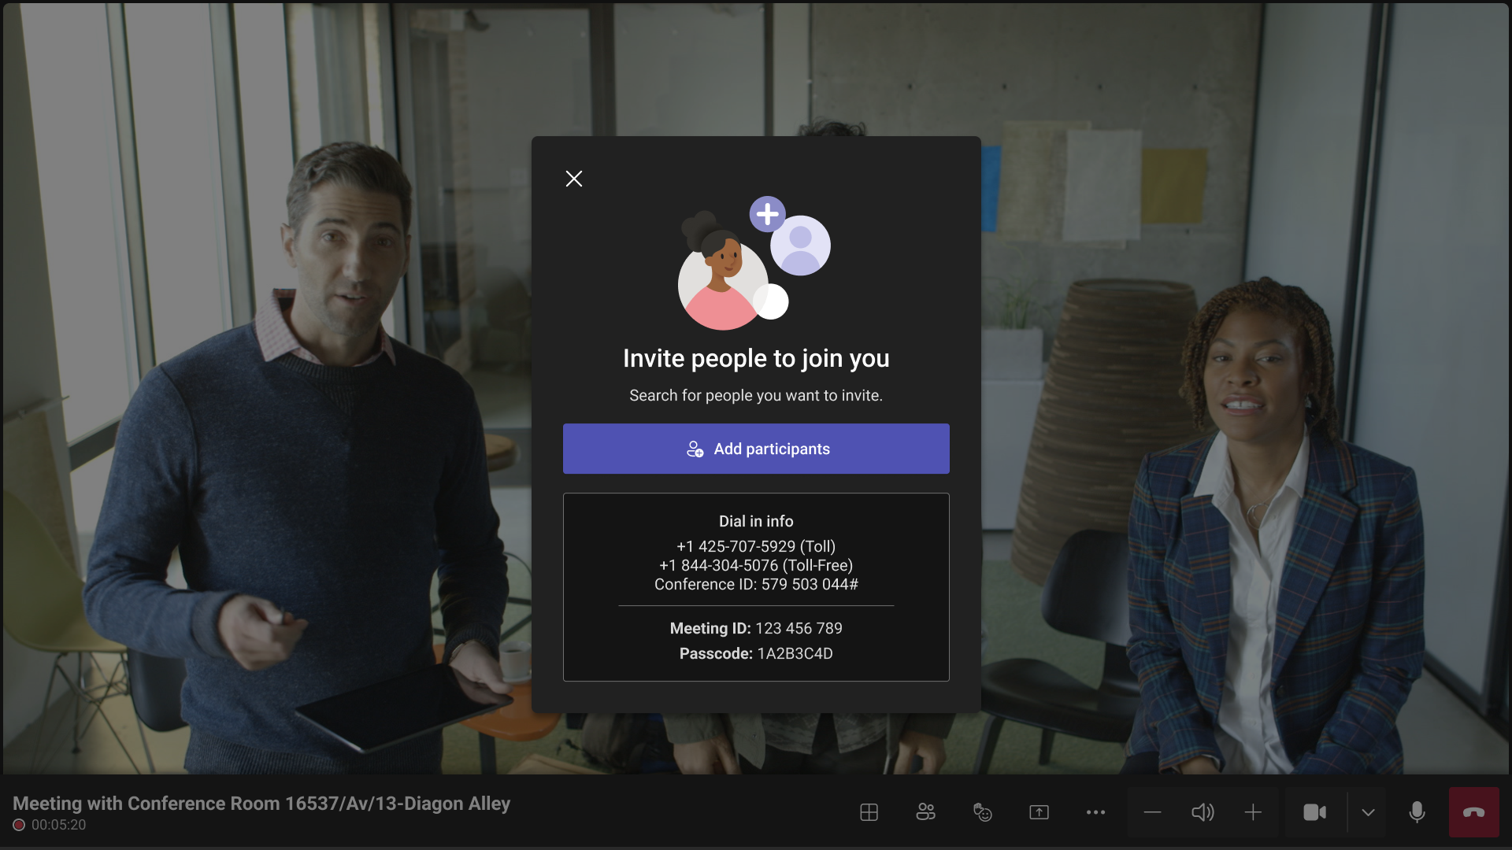
Microsoft Teams Rooms on Android: User Experience Update 1 2023
Notes:
Meet app updates

Slide 48
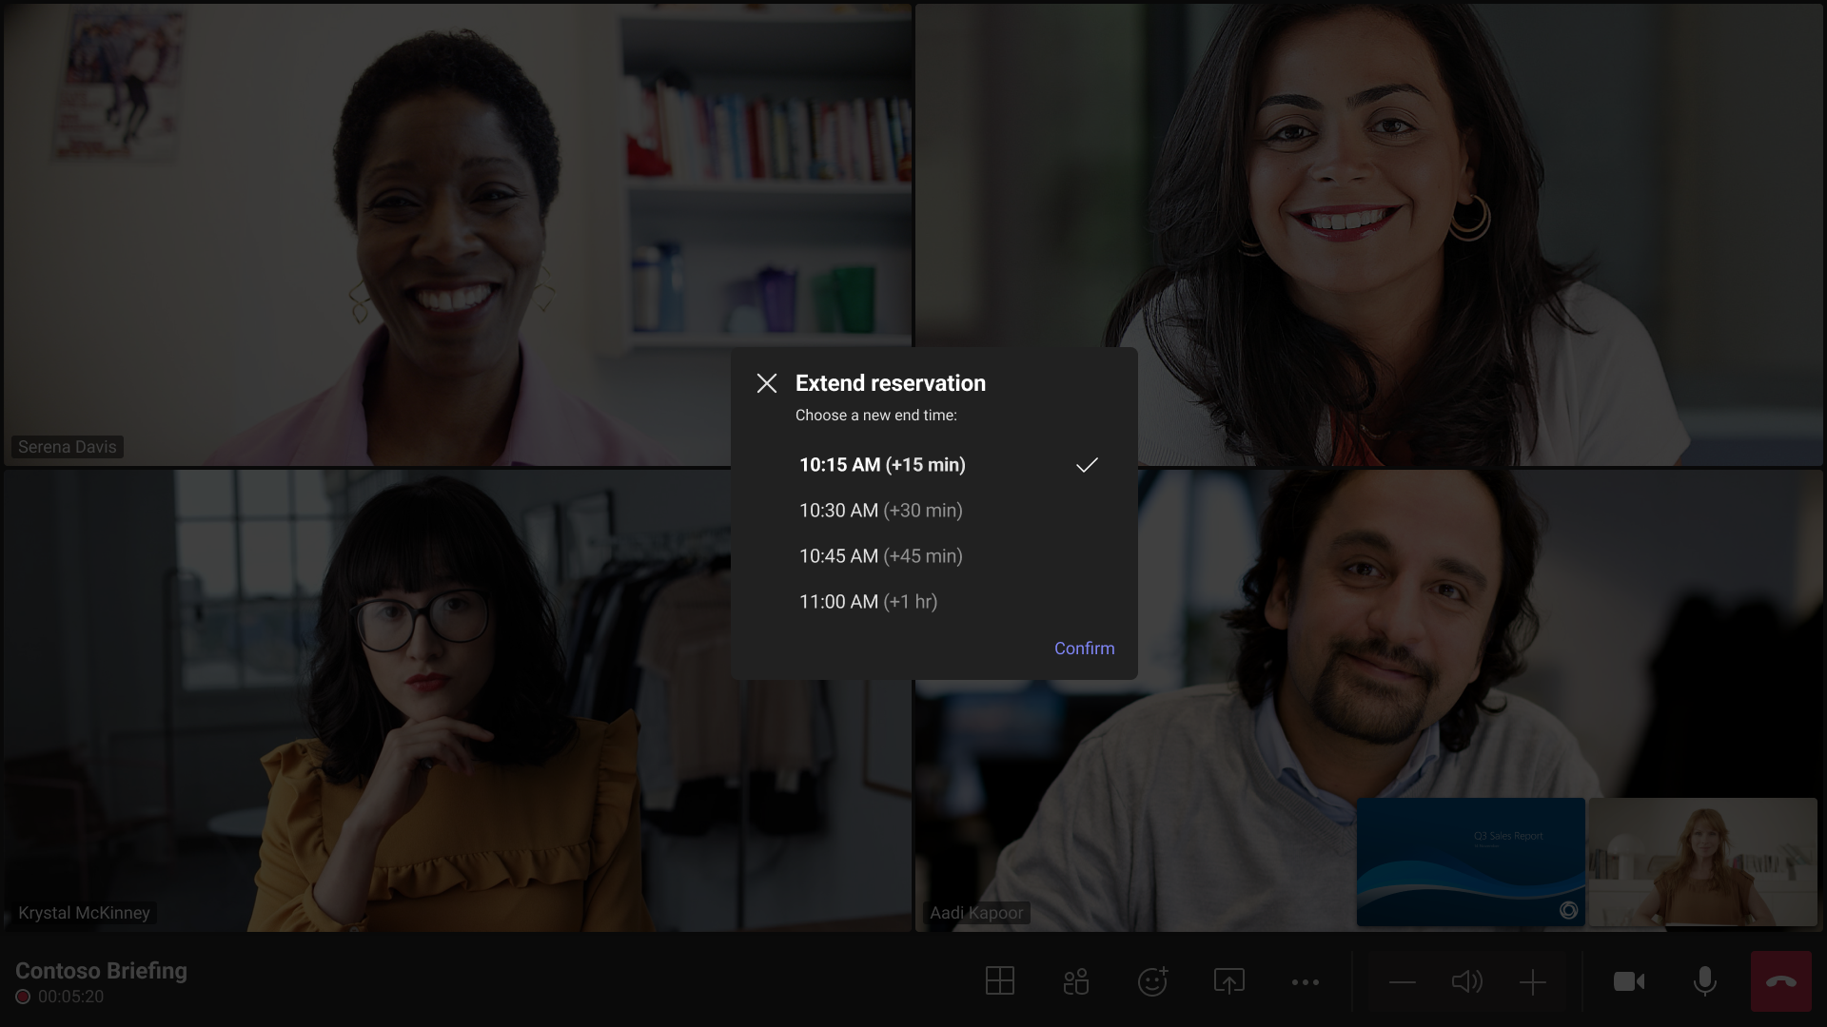
Microsoft Teams Rooms on Android: User Experience Update 1 2023
Notes:
Room reservation extension

Slide 49

Microsoft Teams Rooms on Android: User Experience Update 1 2023
Notes:
Front row
Front row is a layout designed to enhance hybrid meetings for in-room participants: users can see remote attendees at eye level, making the interaction more natural between participants regardless of whether they are in-room or remote. Meeting chat is seen on the right panel and, for dual screens, raised hands are displayed on the left panel for increased visibility. Admins can set front row as the default layout in the device settings. Users can also select front row from the layout switcher on the meeting utility bar.

Slide 50
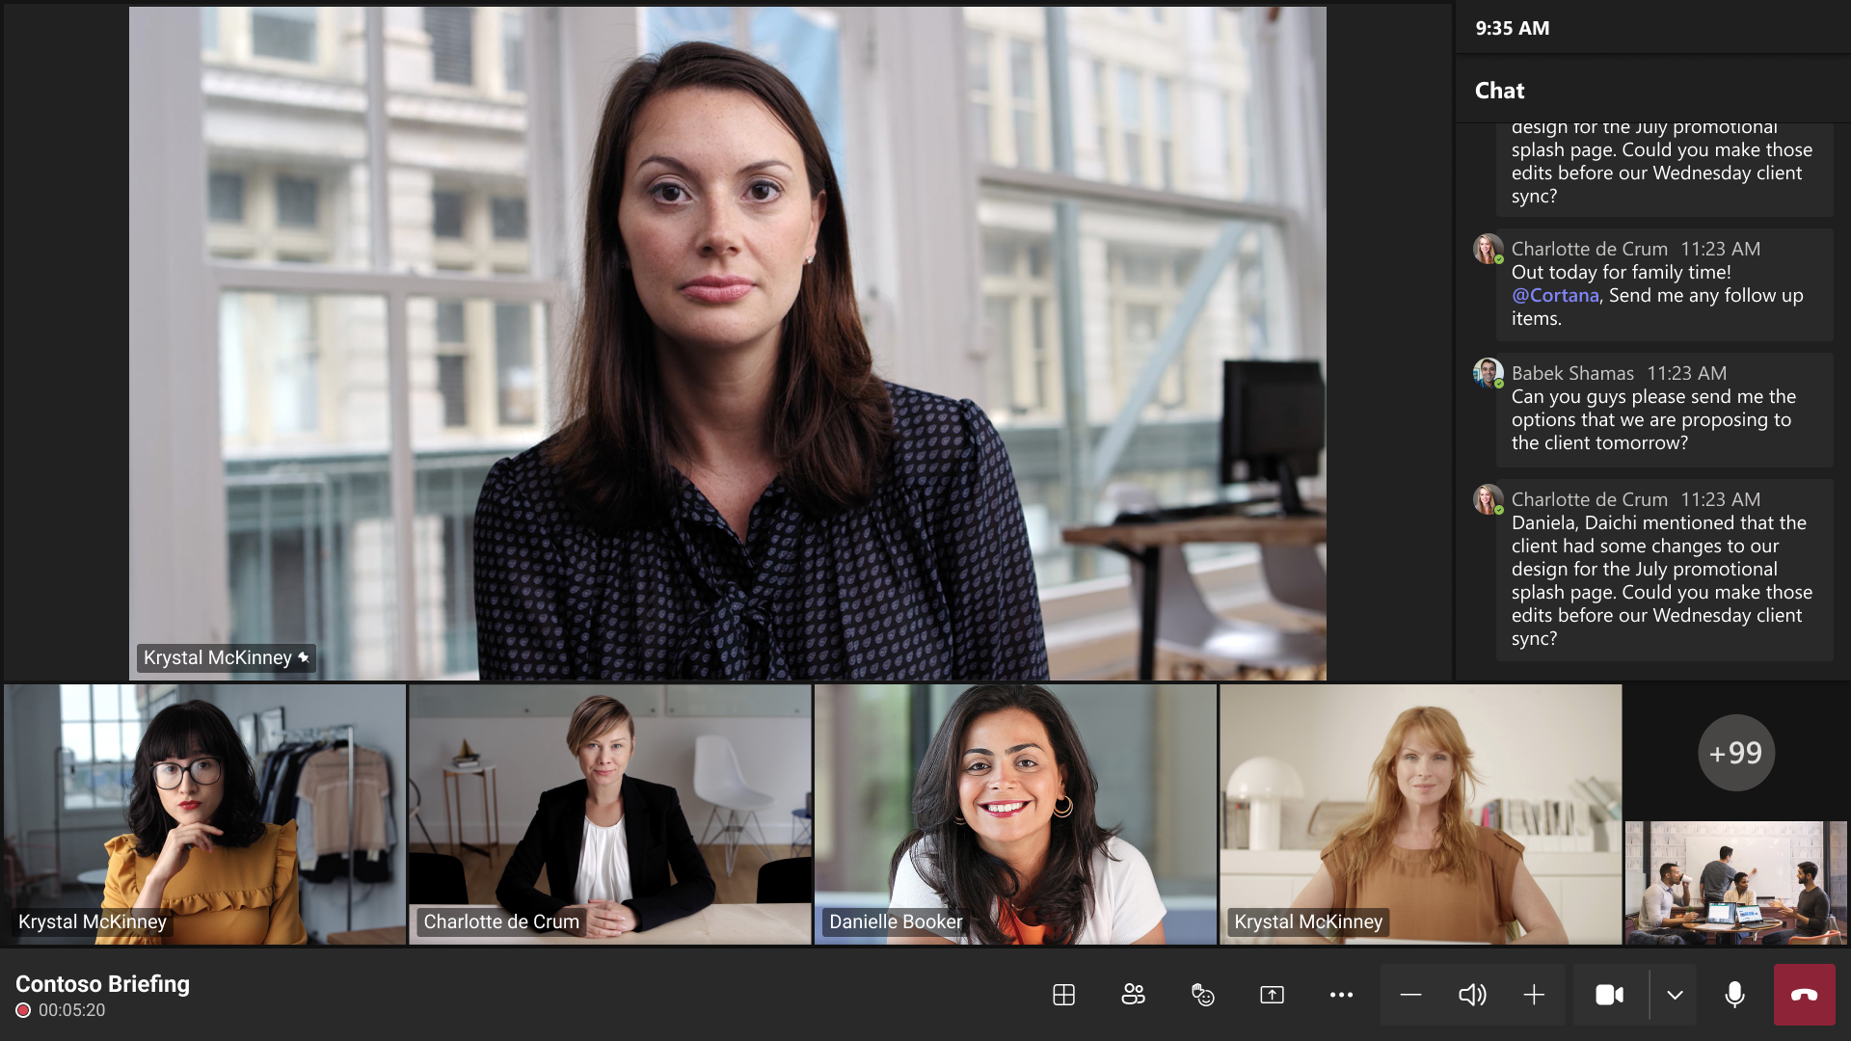
Microsoft Teams Rooms on Android: User Experience Update 1 2023
Notes:
Front row
Front row is a layout designed to enhance hybrid meetings for in-room participants: users can see remote attendees at eye level, making the interaction more natural between participants regardless of whether they are in-room or remote. Meeting chat is seen on the right panel and, for dual screens, raised hands are displayed on the left panel for increased visibility. Admins can set front row as the default layout in the device settings. Users can also select front row from the layout switcher on the meeting utility bar.

Slide 51
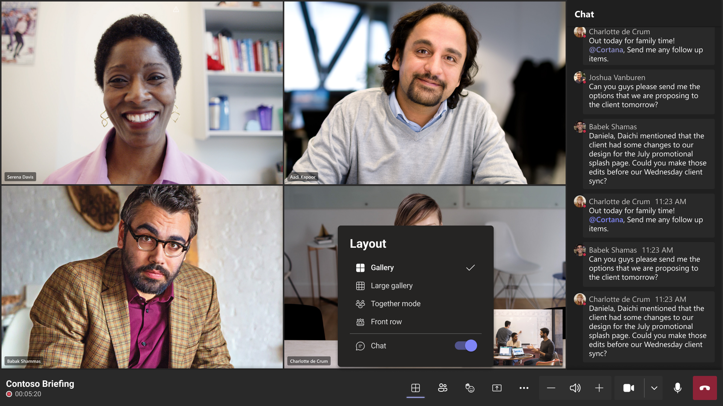
Microsoft Teams Rooms on Android: User Experience Update 1 2023
Notes:
Meeting chat in Gallery, Large gallery, and Together mode
To promote inclusion, users can choose to show meeting chat on the front of room display in any meeting layout using the layout switcher. Admins can disable the "Show meeting chat" setting in the device settings if needed.

Slide 52
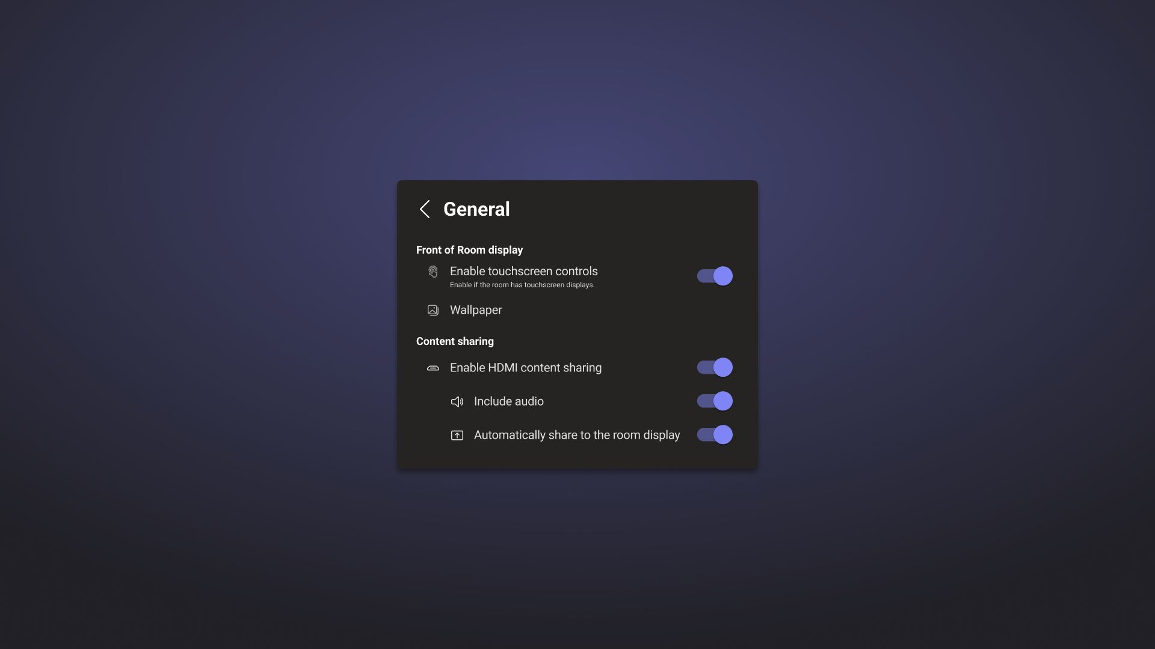
Microsoft Teams Rooms on Android: User Experience Update 1 2023
Notes:
HDMI auto share controls

Slide 53
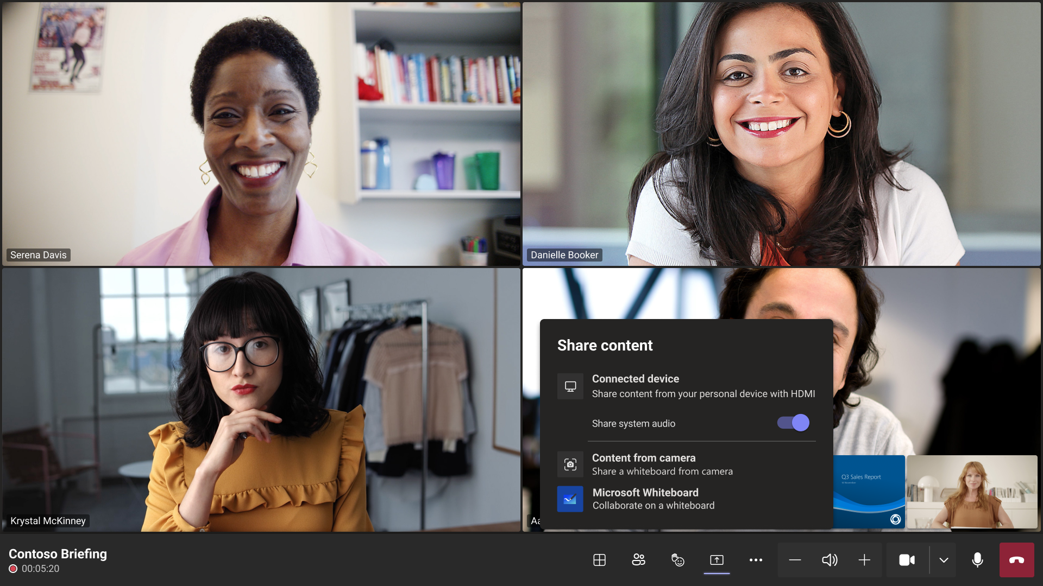
Microsoft Teams Rooms on Android: User Experience Update 1 2023
Notes:
HDMI audio share

Slide 54
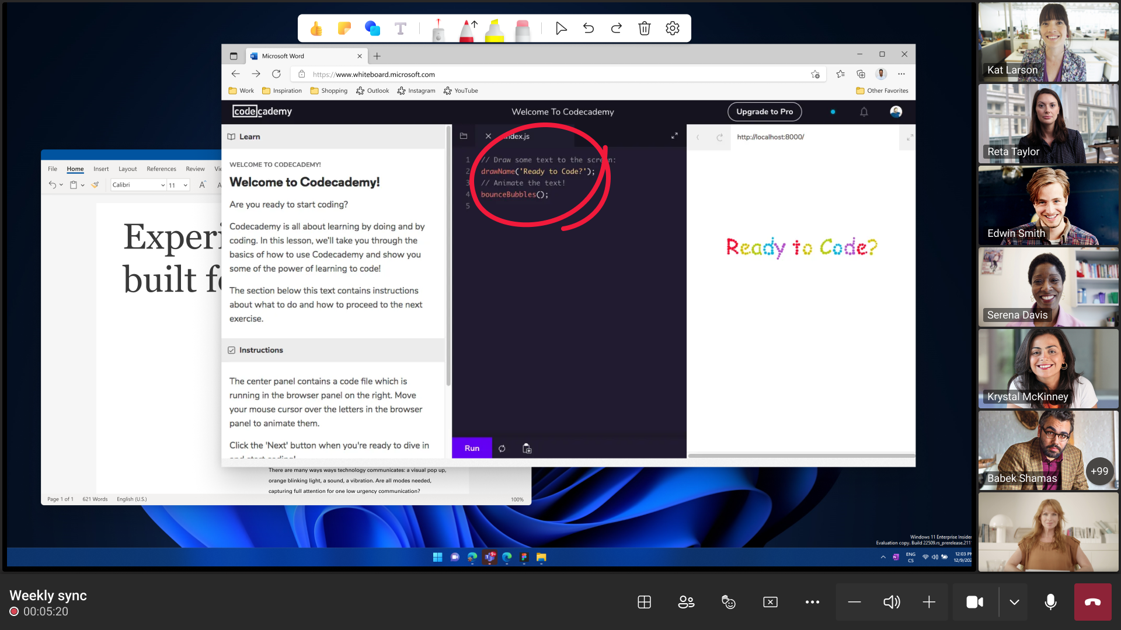
Microsoft Teams Rooms on Android: User Experience Update 1 2023
Notes:
Annotations

Slide 55
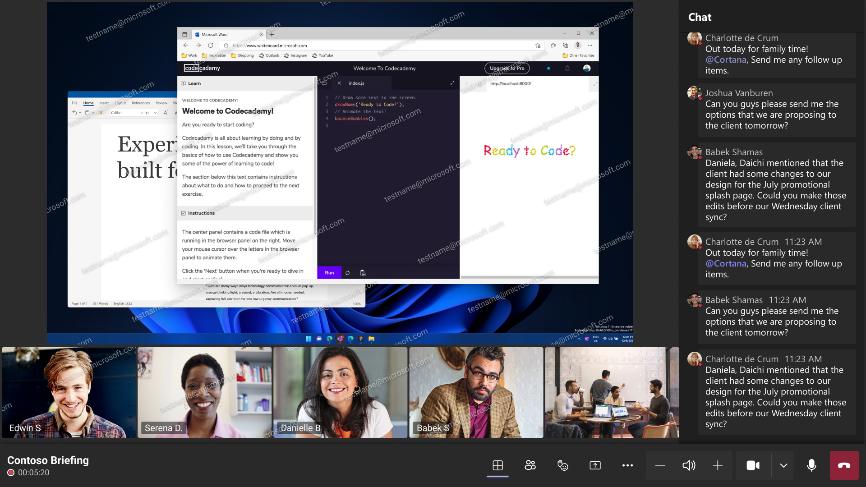
Microsoft Teams Rooms on Android: User Experience Update 1 2023
Notes:
Watermark-enabled meetings support
Teams Premium licensed meeting organizers can safeguard confidential meetings by enabling watermark. Watermark-enabled meetings will show the room account applied as a watermark on top of supported shared content and the video participants' camera stream to deter leaks.

Slide 56
Neuigkeiten in Microsoft Teams für Admins
New Lobby Policy for Webinar
Webinar Email feature updates - customize content and time to send reminders
Breakout Rooms participant shuffle
Install apps based on user activity with Auto install approved apps (AAA)

Slide 57
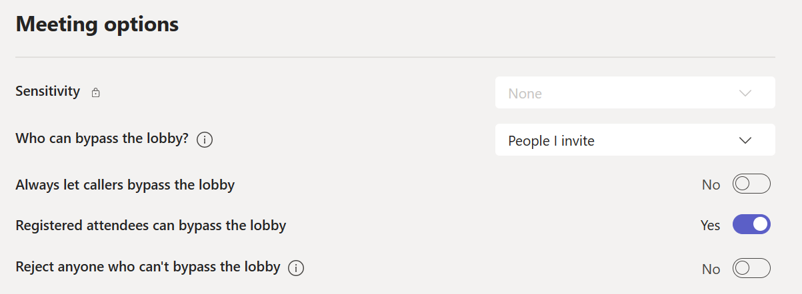
New Lobby Policy for Webinar
Notes:
A new 'Allow registered users to bypass' lobby policy that allows registered users to bypass the lobby in your webinar.
A new 'Reject users who cannot bypass the lobby' that rejects users who cannot bypass the lobby.

Slide 58
Neuigkeiten in Microsoft Teams für Admins
New Lobby Policy for Webinar
Webinar Email feature updates - customize content and time to send reminders
Breakout Rooms participant shuffle
Install apps based on user activity with Auto install approved apps (AAA)

Slide 59
Webinar Email feature updates - customize content and time to send reminders
Anpassung des Inhalts der Webinar E-Mail-Nachricht durch Organisatoren (Premium)
Anpassung der Versandzeit einer Erinnerungs-E-Mail (Premium)
Möglichkeit der Anpassung wird durch Teams Richtlinien kontrolliert
Notes:
https://learn.microsoft.com/de-de/powershell/module/teams/set-csteamseventspolicy?view=teams-ps

Slide 60
Neuigkeiten in Microsoft Teams für Admins
New Lobby Policy for Webinar
Webinar Email feature updates - customize content and time to send reminders
Breakout Rooms participant shuffle
Install apps based on user activity with Auto install approved apps (AAA)

Slide 61
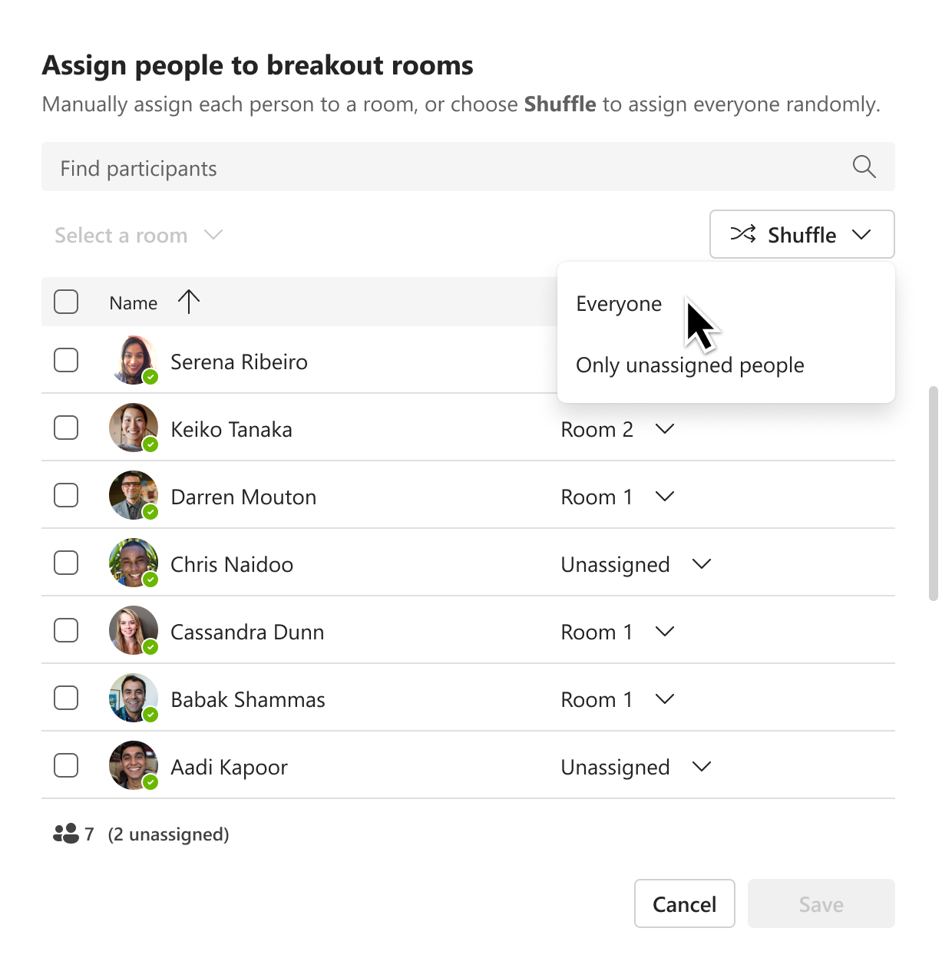
Breakout Rooms participant shuffle

Slide 62
Neuigkeiten in Microsoft Teams für Admins
New Lobby Policy for Webinar
Webinar Email feature updates - customize content and time to send reminders
Breakout Rooms participant shuffle
Install apps based on user activity with Auto install approved apps (AAA)

Slide 63
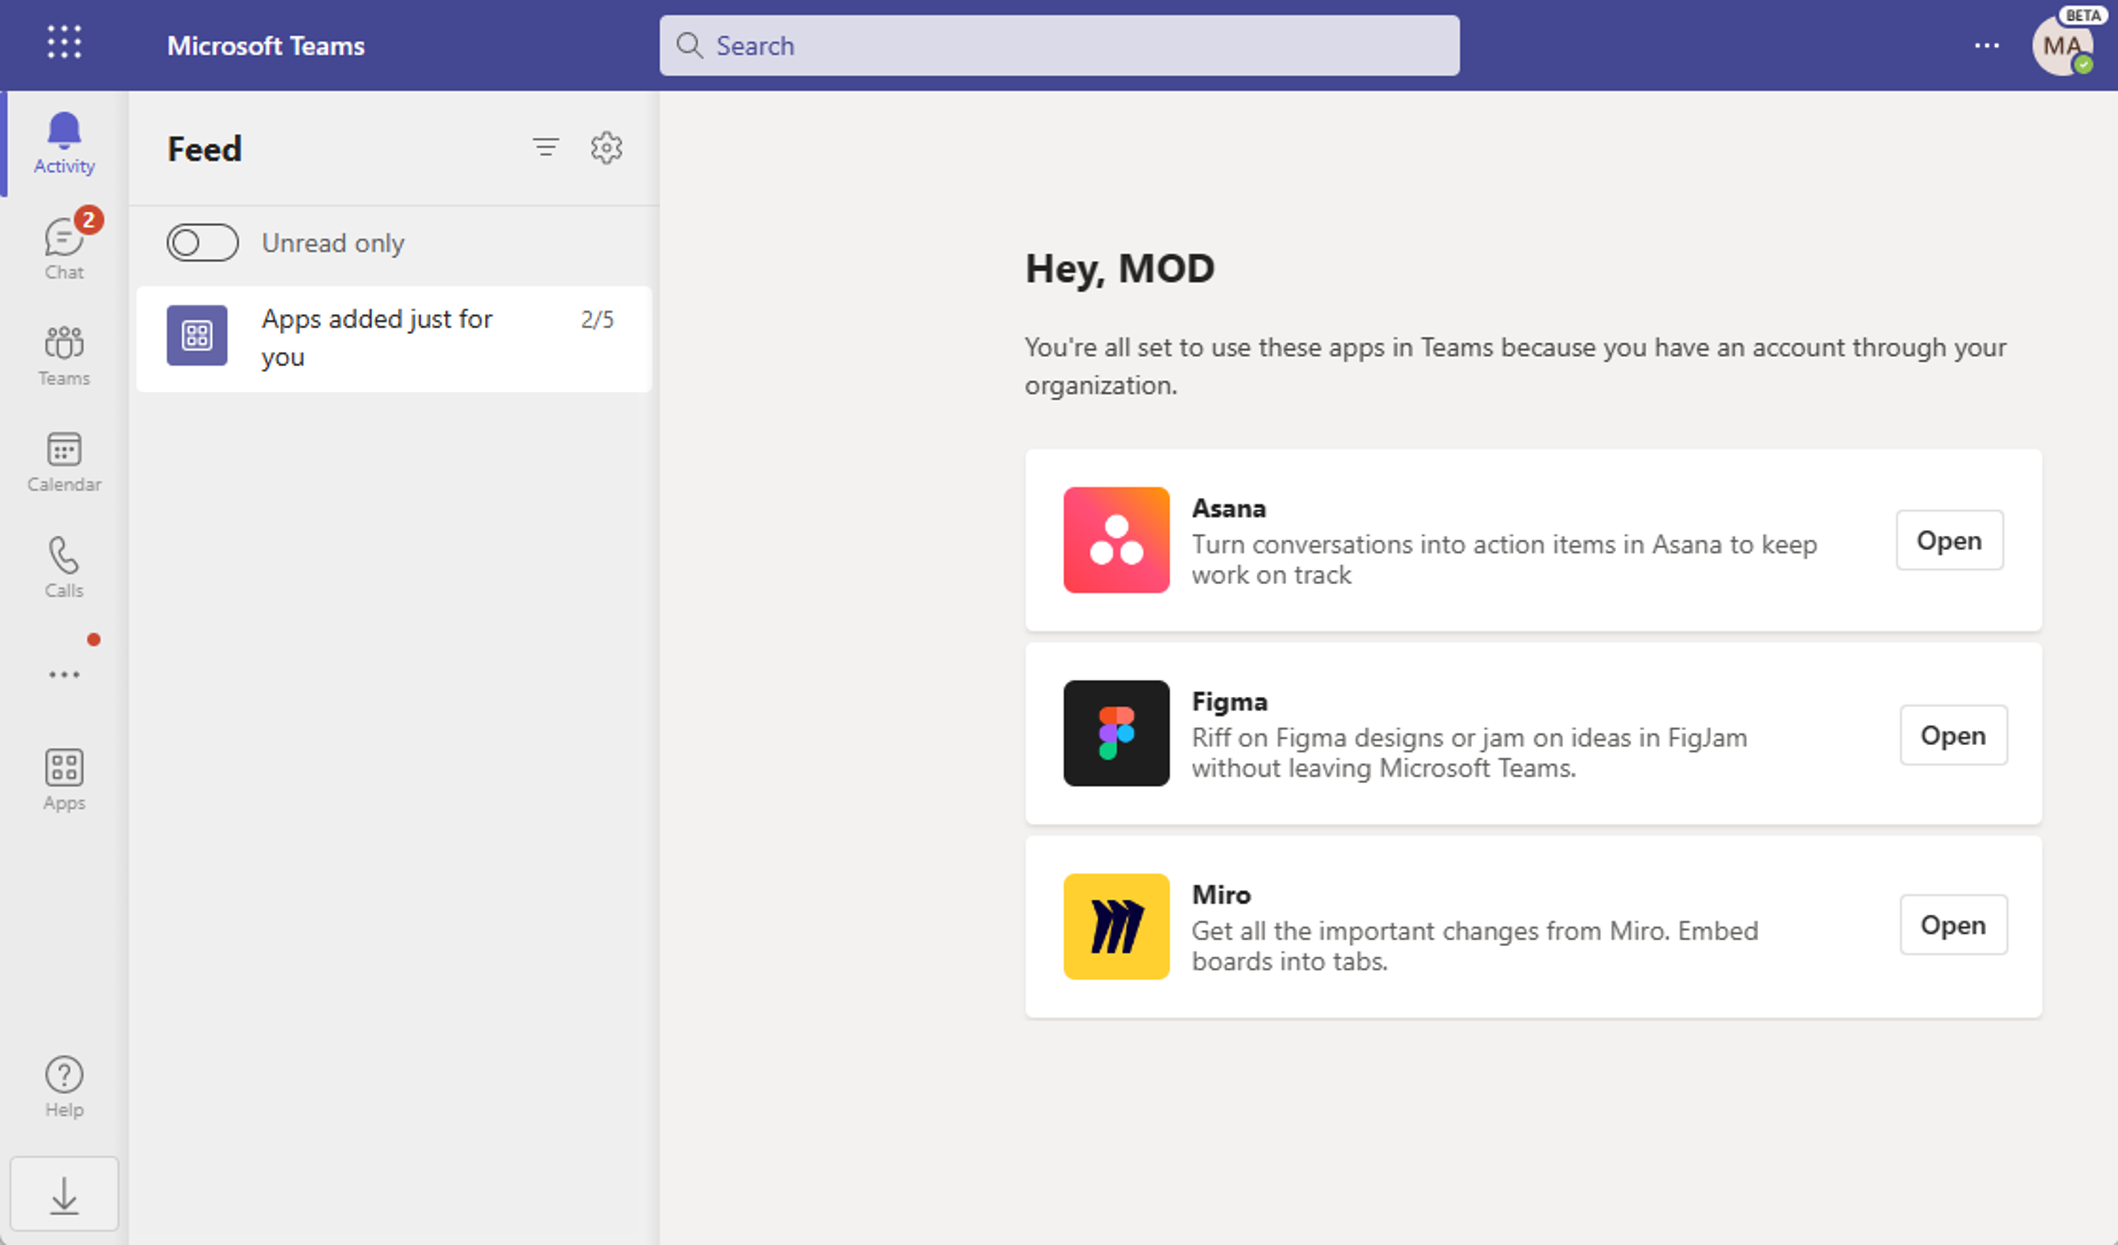
Install apps based on user activity with Auto install approved apps (AAA)
Notes:
Microsoft Teams Auto install approved apps (AAA) uses activity from your users to install and surface apps that admins have already allowed for the tenant. An admin can enable AAA to help users naturally discover and use apps that are highly relevant to their needs within Microsoft Teams. Specifically, when a user signs into specific SaaS apps using Azure AD (e.g. in web browser), the app will be installed for that user on Teams.
AAA provides the right apps to the right users at the right time. Admins and users benefit from:
App governance is respected: there is an admin control to turn ON/OFF, launched as default OFF. Installs will not happen for blocked apps and users.
Last-mile delivery: admins have done the hard part of deciding which apps/users to allow. AAA simply helps roll out these apps to the right users.
Cross-platform convenience: users can easily access the same apps they are currently using on other platforms, now in Teams.
Discovery: many users are not aware their apps are available on Teams - AAA brings it to them without manually searching in the app store.
License maximization: maximize the value of SaaS licenses by having the same app available on multiple platforms.

Slide 64
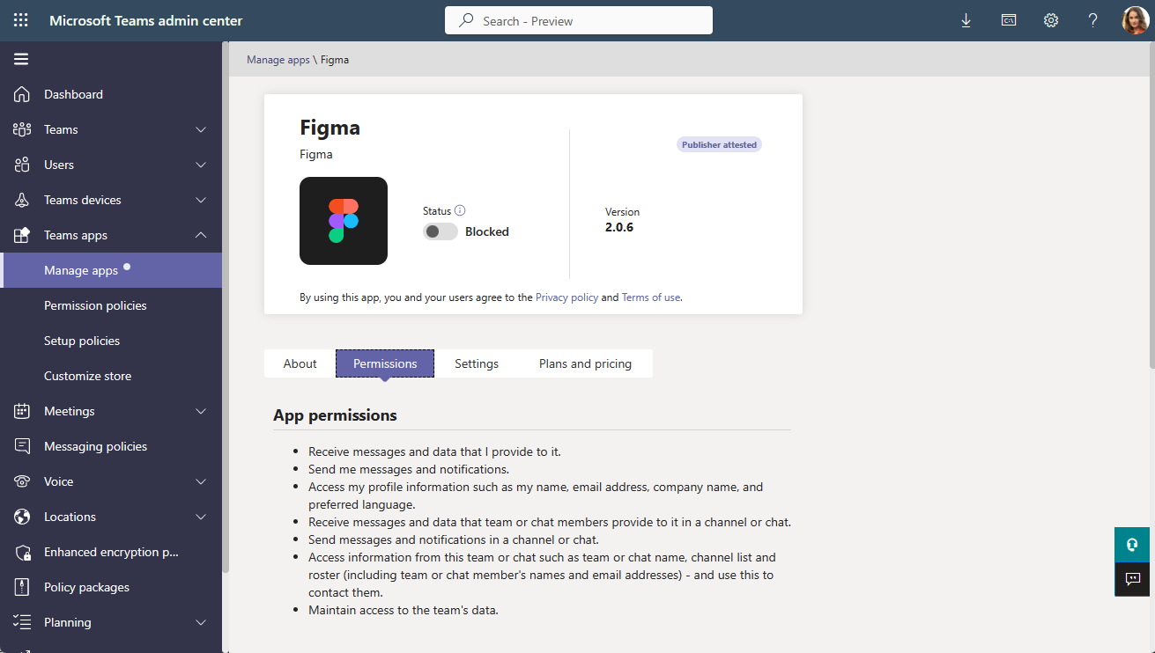
Install apps based on user activity with Auto install approved apps (AAA)
Notes:
AAA respects all app governance in the Teams Admin Center.
Admin control to turn AAA ON/OFF with the default as OFF.
Installs only for users and apps that admins have allowed through settings and policies.
A limited set of apps are initially supported. New apps will be deployed OFF with Message Center posts and visual indicators inside Teams Admin Center

Slide 65
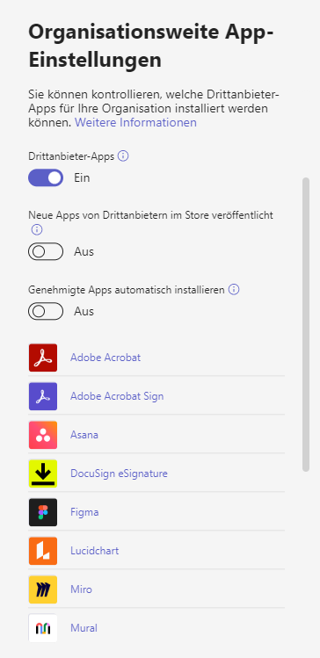
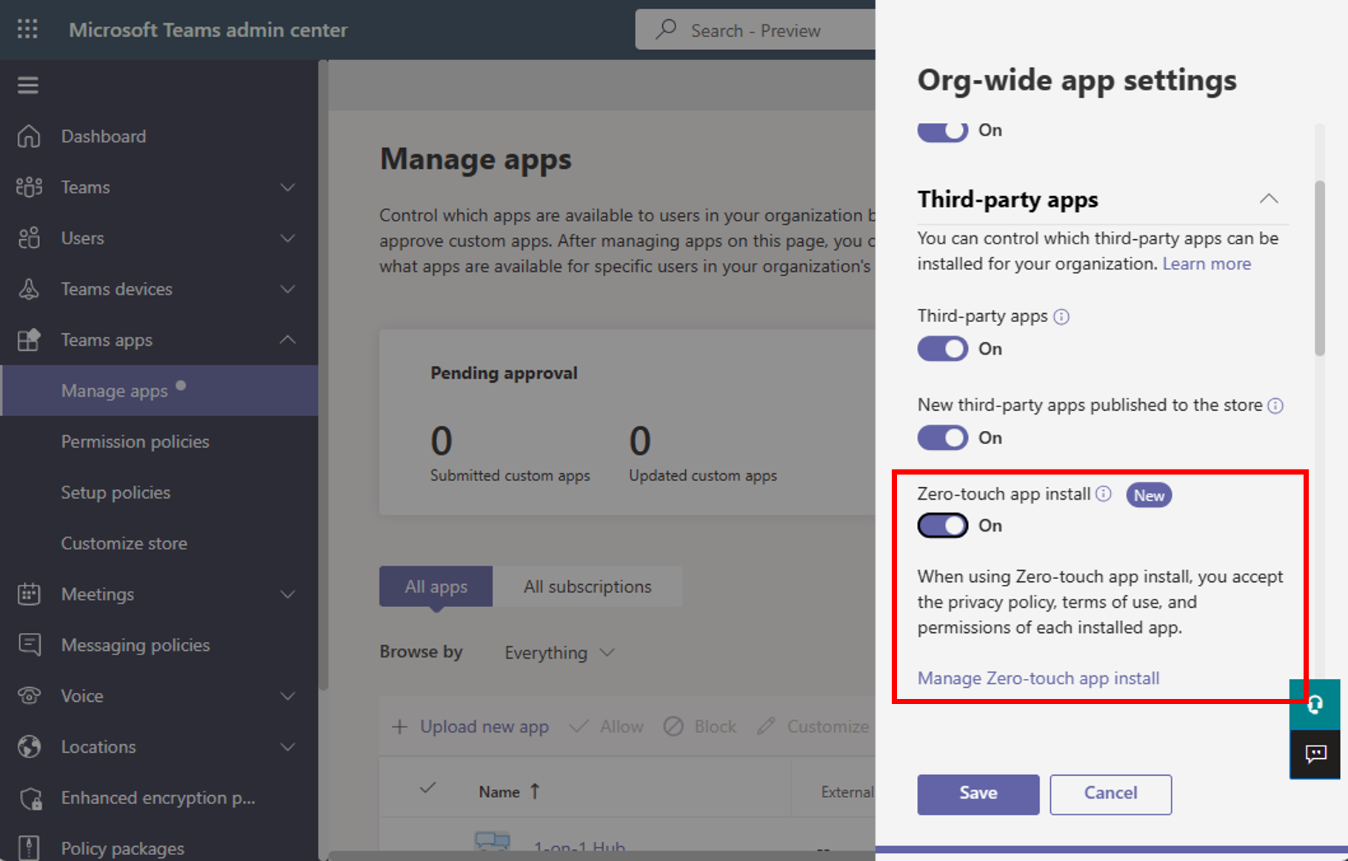
Install apps based on user activity with Auto install approved apps (AAA)
Notes:
AAA respects all app governance in the Teams Admin Center.
Admin control to turn AAA ON/OFF with the default as OFF.
Installs only for users and apps that admins have allowed through settings and policies.
A limited set of apps are initially supported. New apps will be deployed OFF with Message Center posts and visual indicators inside Teams Admin Center

Slide 66
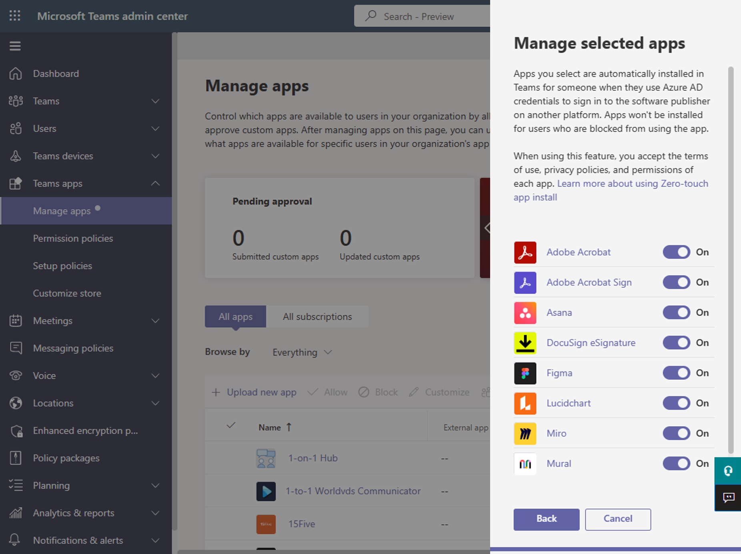
Install apps based on user activity with Auto install approved apps (AAA)
Notes:
Some Teams apps require Graph app permissions during use. Ensure users can smoothly use apps after installation by confirming Graph app permissions have been or can be consented. Complete one or both of the following:
Allow users to consent to Graph permissions. This is the default setting for Azure AD and no action is needed if no admins have changed it. Learn more
Grant admin consent to Graph permissions so users will not need to for each AAA app that users are signing into. Learn more
https://learn.microsoft.com/de-de/microsoftteams/auto-install-approved-apps

Slide 68
Teams Premium – Was, Wie, Warum?
Christian Olschewski / Thomas Stensitzki

Slide 69
Was ist Teams Premium?
Teams Premium ist eine Add-On-Lizenz
Die Lizenz ist seit 3. Februar 2023 verfügbar
Freie Premium-Preview Funktionen sind inzwischen abgeschaltet und stehen nur noch mit Lizenz zur Verfügung

Slide 70
Was bietet Teams Premium?
Corporate Identity-Anpassungen für Besprechungen
Meeting Lobby (Hintergrundgrafik und Farbe der Schaltflächen)
Hintergrundbilder für Besprechungen
Individuelle Szenen für den Zusammenmodus
Besprechungsvorlagen
Vordefinierte Vorlage Virtueller Termin
Erstellung von Besprechungsvorlagen mit vordefinierten Einstellungen
Vorbereitungsraum für Referenten
Von Teilnehmenden unabhängiger Besprechungsraum (Green Room)
Namensausblendung von Teilnehmenden im Webinar

Slide 71
Was bietet Teams Premium?
Virtuelle Termine
SMS-Erinnerungen
Termin-Warteschlangen mit Corporate Design
Berichte zu Nutzungstrend und Verlauf virtueller Termine
Erweiterter Besprechungsschutz
Wasserzeichen für Video und geteilte Inhalte
E-Mail-Adresse der zuschauenden (teilnehmenden) Person dient als Wasserzeichen
KI-unterstützte Besprechungen
Automatische Erkennung von möglichen Aufgaben
Liveübersetzung von Untertiteln

Slide 72
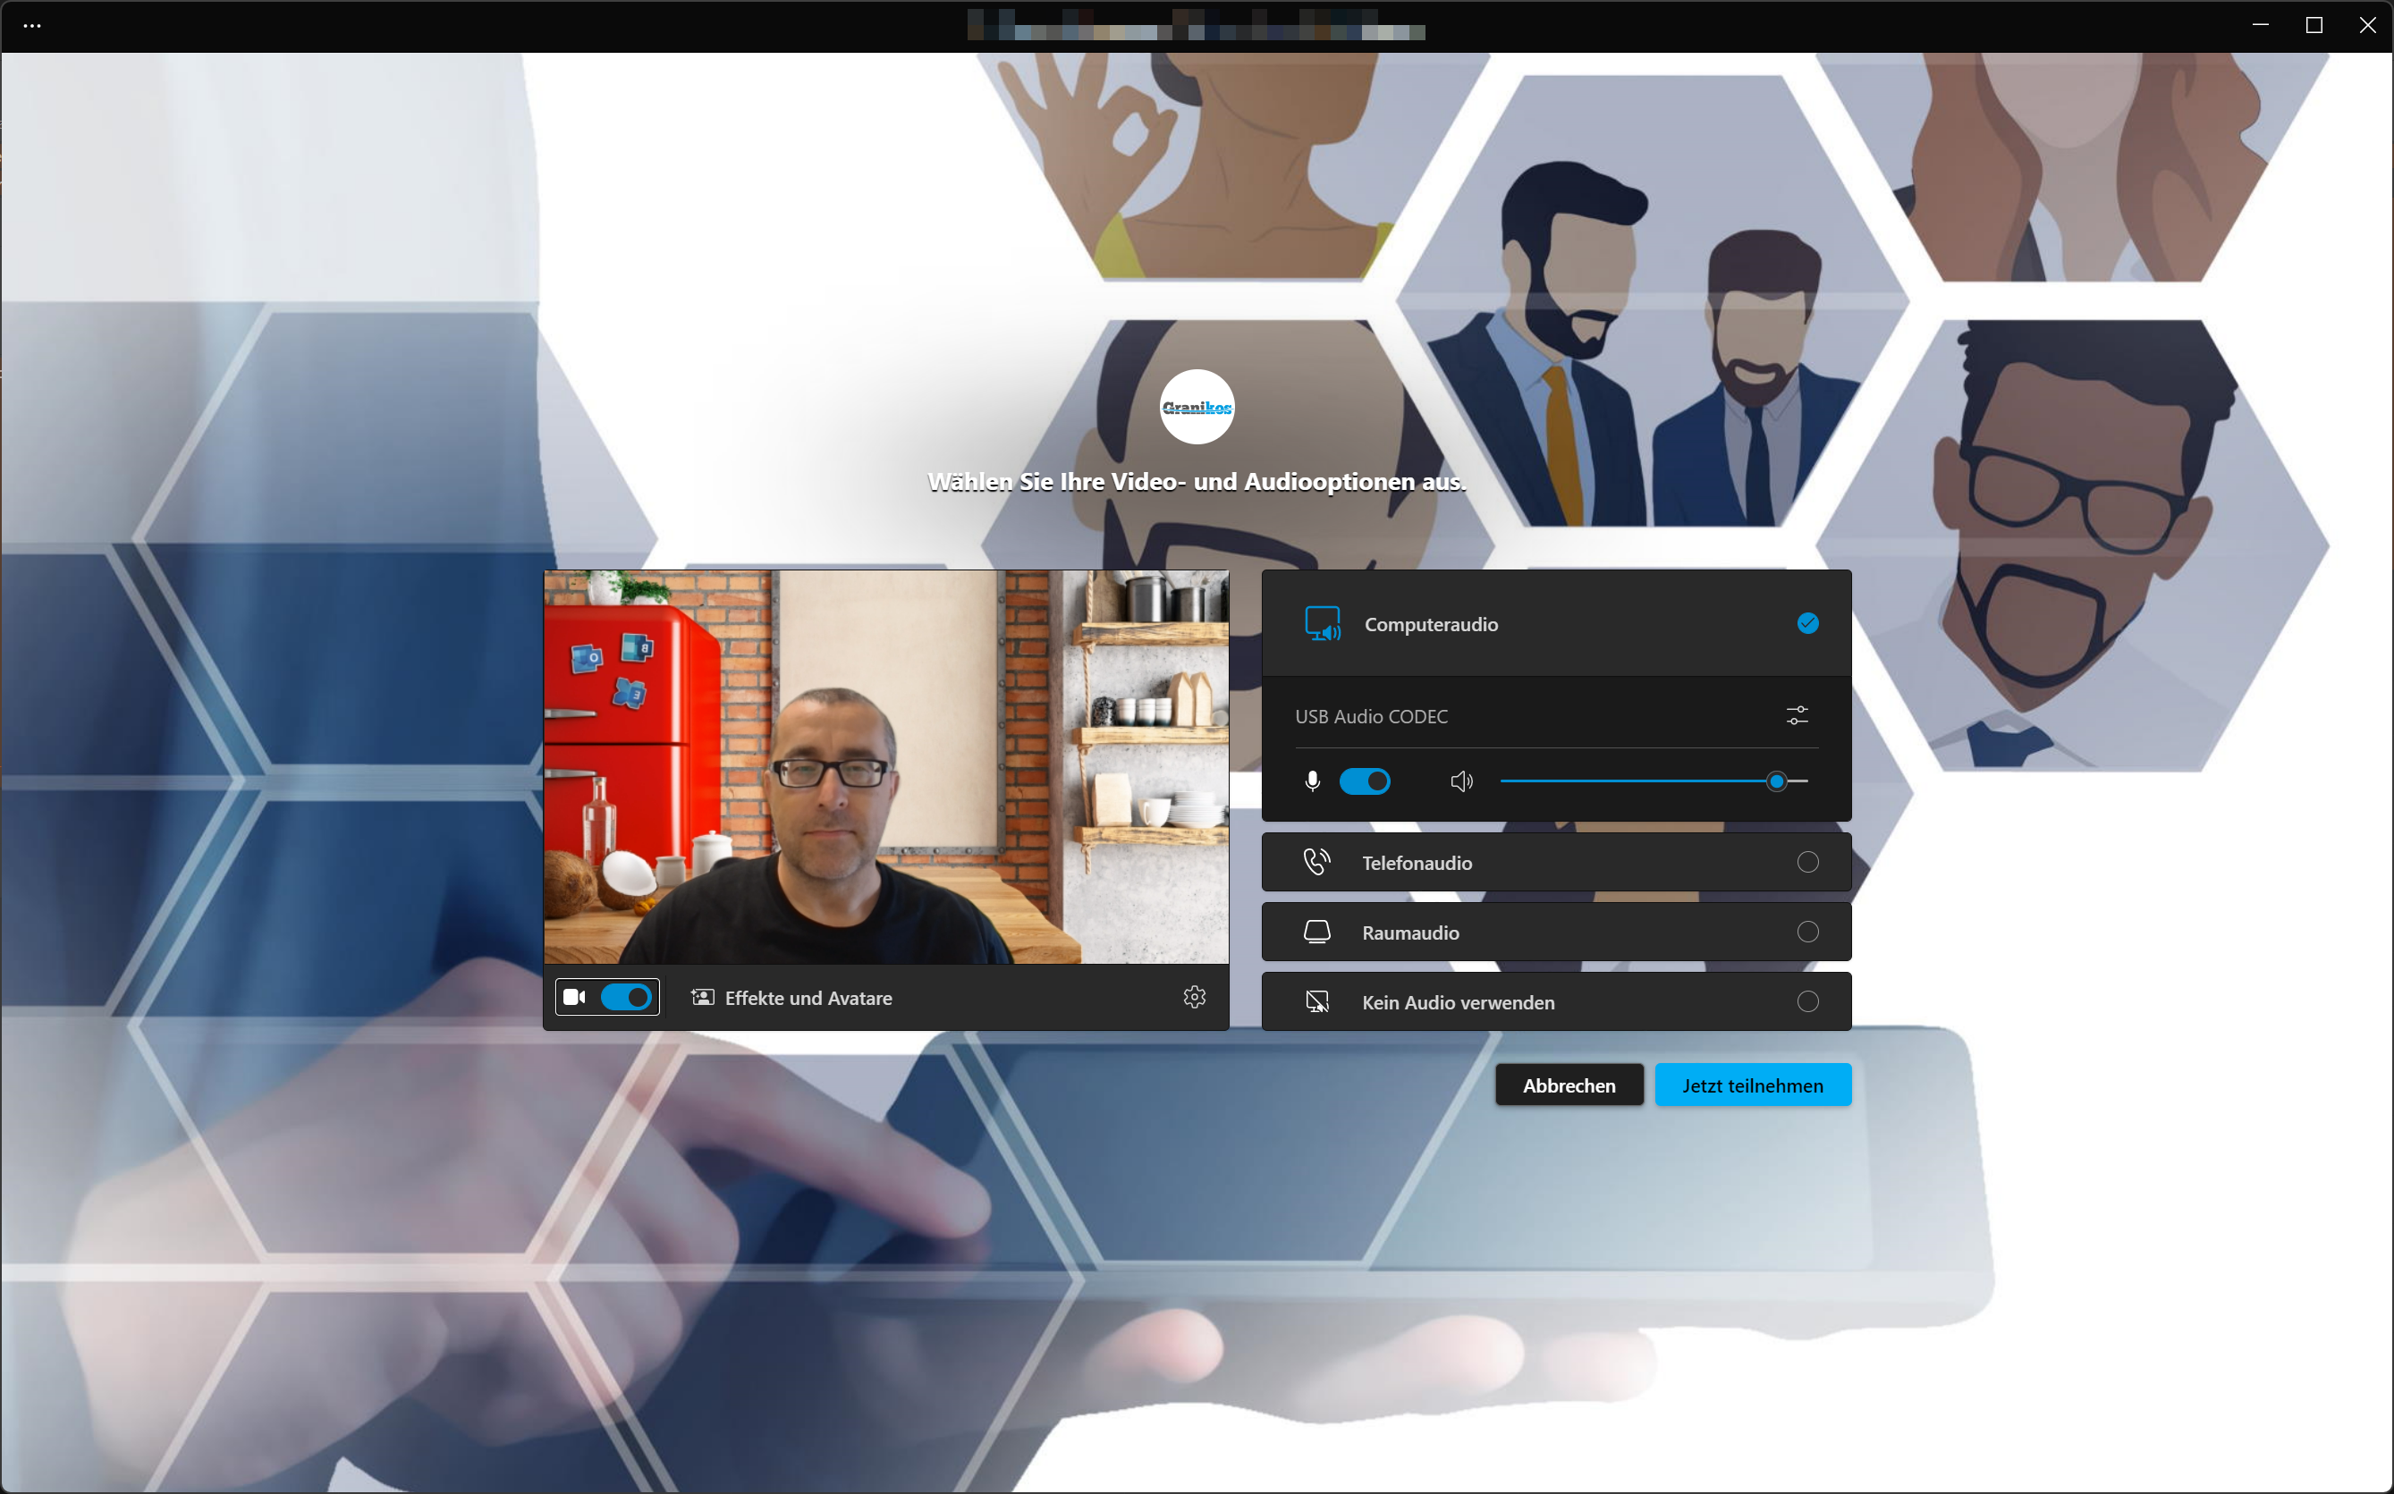
Meeting Lobby

Slide 73
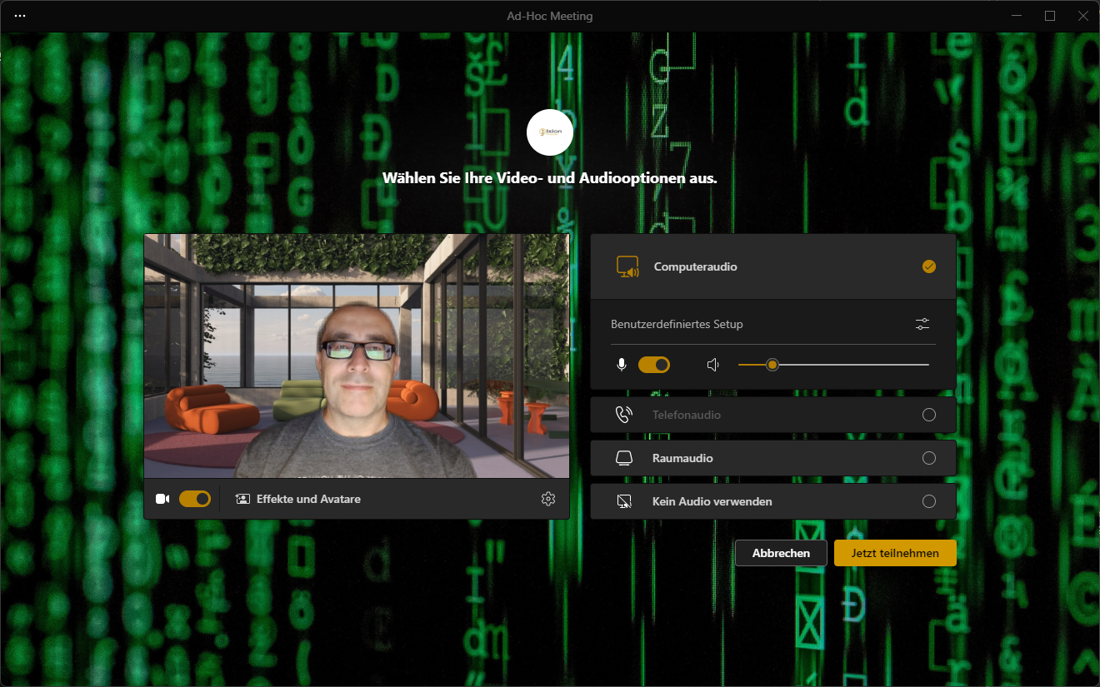
Meeting Lobby

Slide 74
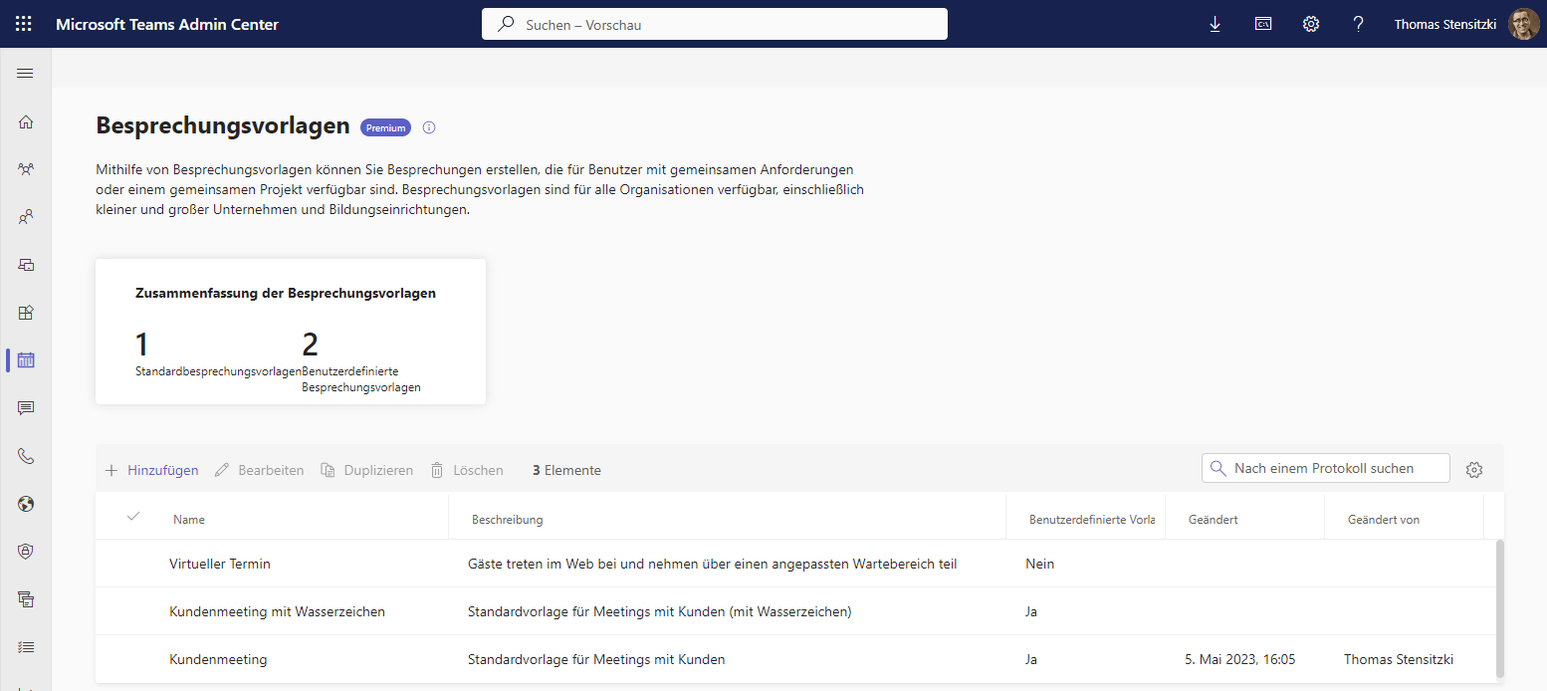
Besprechungsvorlagen

Slide 75
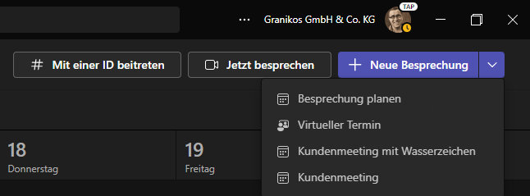
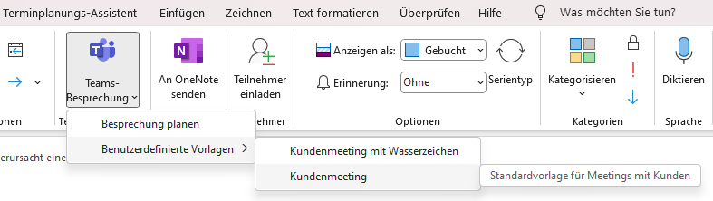
Besprechungsvorlagen

Slide 76
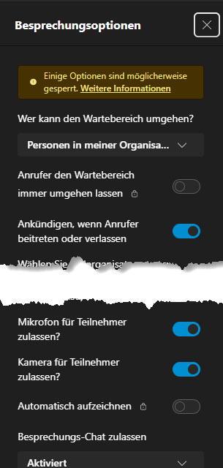
Besprechungsvorlagen

Slide 77
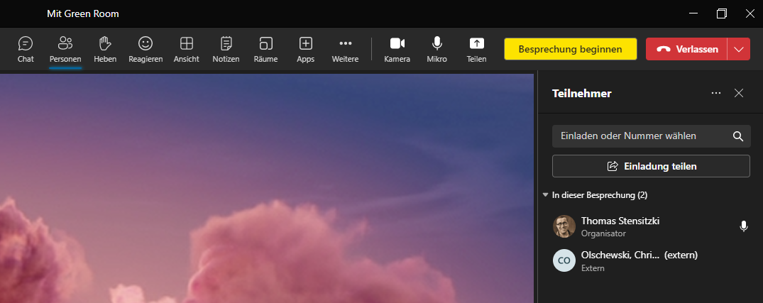
Warteraum

Slide 78
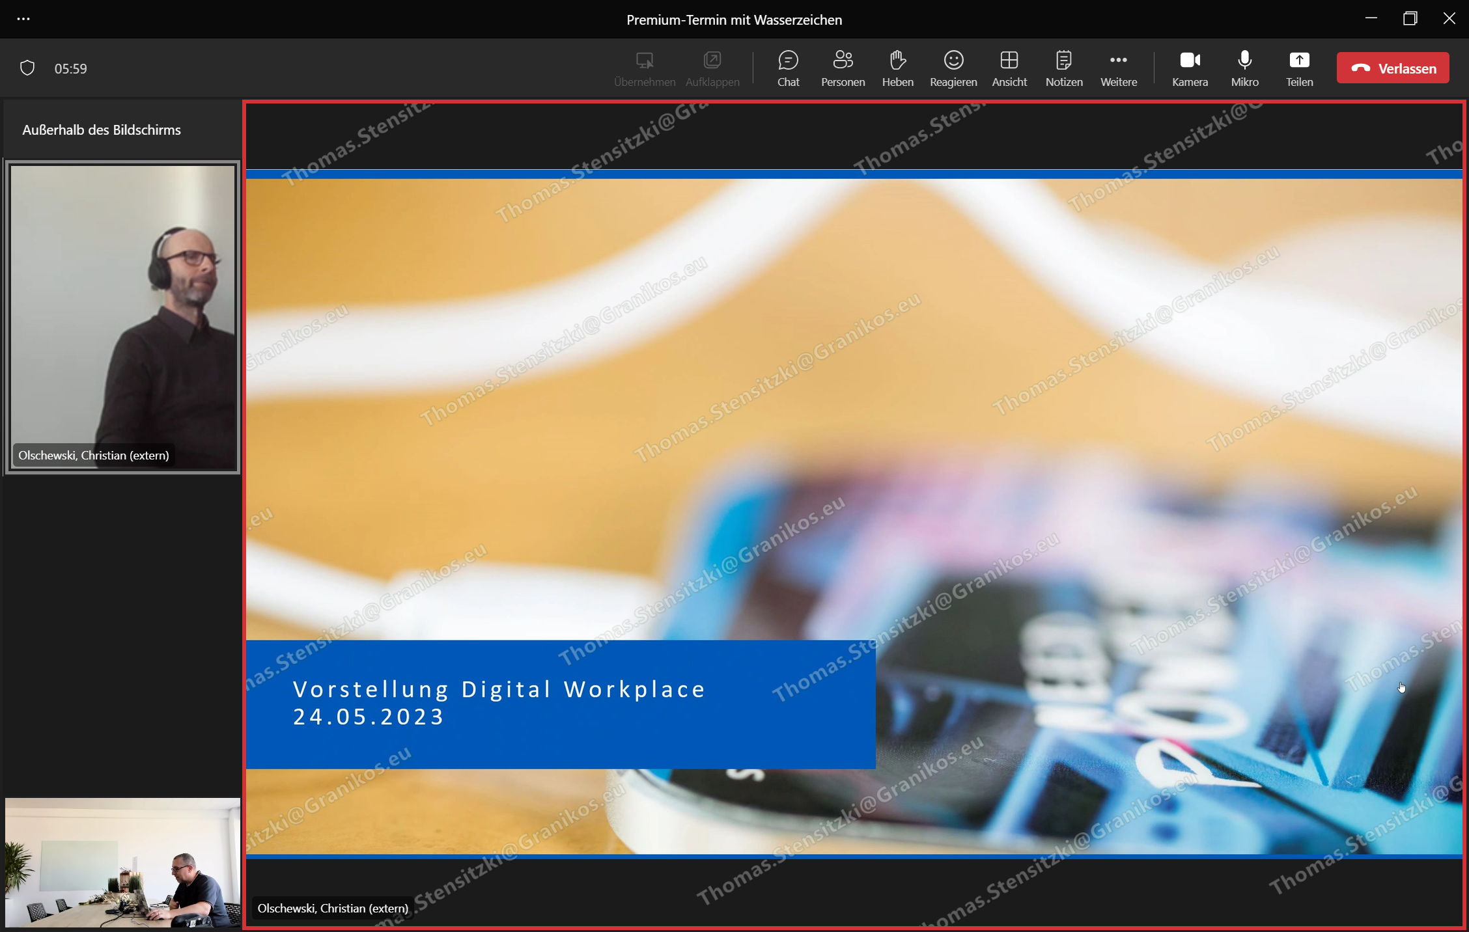
Besprechung mit Wasserzeichen

Slide 79
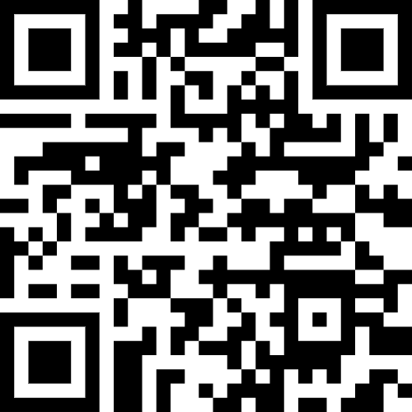
Demo
Teams Premium

Slide 80
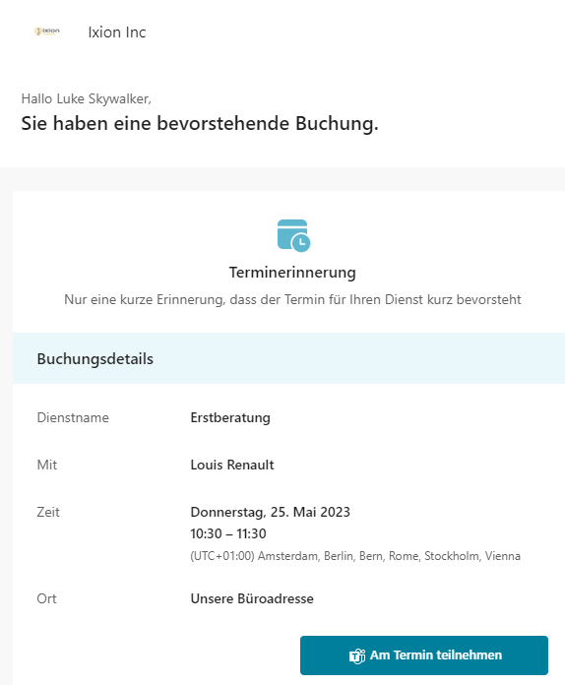
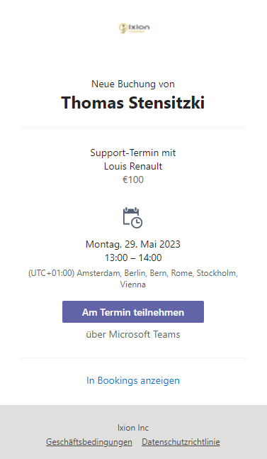
Virtueller Termin - Benachrichtigung
Gast
Gastgeber

Slide 81
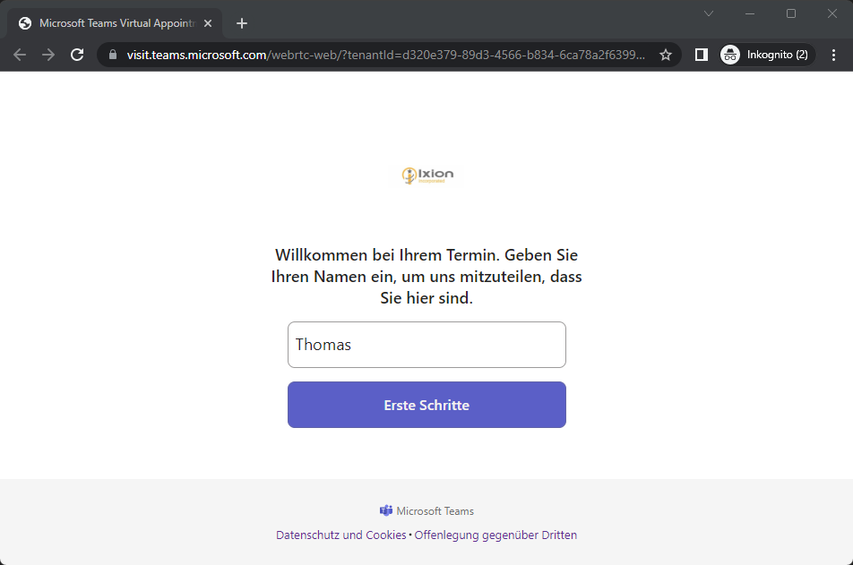
Virtueller Termin – Gast Teilnahme

Slide 82
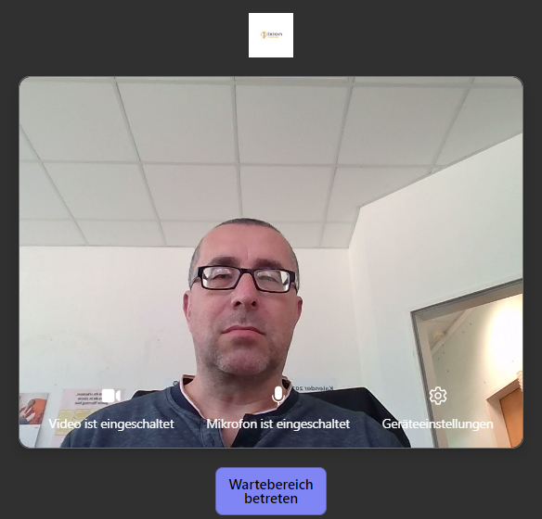
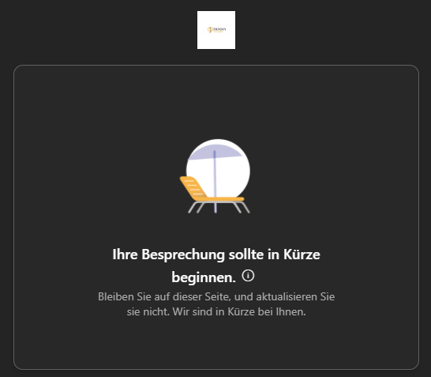

Virtueller Termin – Gast Teilnahme

Slide 83

Virtueller Termin – Übersicht geplanter Termine

Slide 84

Virtueller Termin – Gast zulassen

Slide 85

Virtuelle Termine
Quelle: Introducing Advanced Virtual Appointments in Microsoft Teams Premium, Oktober 2022

Slide 86
Ausblick
Teams Premium wird um weitere Funktionen ergänzt werden
Welche das sind, ist leider NDA ☺

Slide 87
Ressourcen
Teams Premium Blog
Get Started with Microsoft Teams Premium
Microsoft Bookings Blog
https://techcommunity.microsoft.com/t5/microsoft-bookings-blog/bg-p/Office365BusinessAppsBlog

Slide 89
Microsoft Teams – Links
What’s New in Microsoft Teams | January 2023
What’s New in Microsoft Teams for Education | January 2023
Microsoft Teams Blog
Microsoft Teams Community Blog
Microsoft Teams Feedback Portal

Slide 90

https://admin.microsoft.com/#/MessageCenter

Slide 91
Organisatorisches

Slide 92

Teams Community Blog
→https://aka.ms/TeamsCommunityBlogger

Slide 93


Microsoft Community
https://aka.ms/MSCommunityLinkedIn

Slide 94

Organisatorisches
Microsoft Community Tenant für User Groups
Teilnahme als Microsoft 365 Gast
Anmeldung: https://go.granikos.eu/TeamsUGForm
Teams Meeting Teilnahme-Link
https://teamsusergroup.berlin/meetup
Teams User Group Aufzeichnungen
https://teamsusergroup.berlin/video

Slide 95

Vielen Dank für eure Teilnahme!
Das nächste Meetup:
→ 6. Juli 2023
https://TeamsUserGroup.Berlin/register
Spread the Word!
#TeamsUGBerlin
Aufzeichnungen unserer Meetups sind im Community Team und bei YouTube verfügbar.

Slide 96
Offene Diskussion

